Slide 1

Change Order to Close a PO How to find if an invoice has been paid?

Slide 2
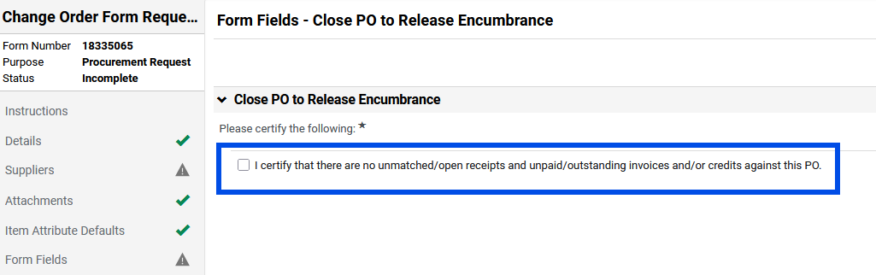
Change Order to Close a PO
When submitting a change order to close a PO, the requestor/submitter must certify that there are no open receipts and no unpaid invoices or credits.
This means that before submitting a change order to close a PO, the invoices and/or credits attached to the PO must be checked to ensure that payment is complete.

Slide 3
Invoice and Credit
An invoice is paid by attaching it to a voucher. An invoice is the supplier’s payment request.
A credit is processed by attaching it to a voucher.
A voucher is processed by Accounts Payable to process an invoice or credit.
The difference between an invoice and a credit is that the credit will be a negative amount to offset the invoice. A credit is typically received by a supplier when an item did not arrive or was returned and is the method that the funds will be received back.
Credits are processed against the PO line for the item or service on the credit. Ex. If a credit is received for line 3 of a PO, Accounts Payable will process the credit on line 3 of the PO, so that line cannot be canceled.

Slide 4
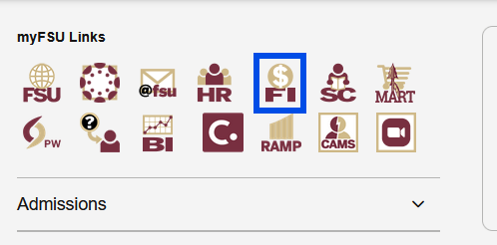
Procedures to Tell if an Invoice Has Paid Out
To tell if an invoice has paid out, you will need to get the invoice or voucher number. First, go to your myFSU page and click on FI.

Slide 5
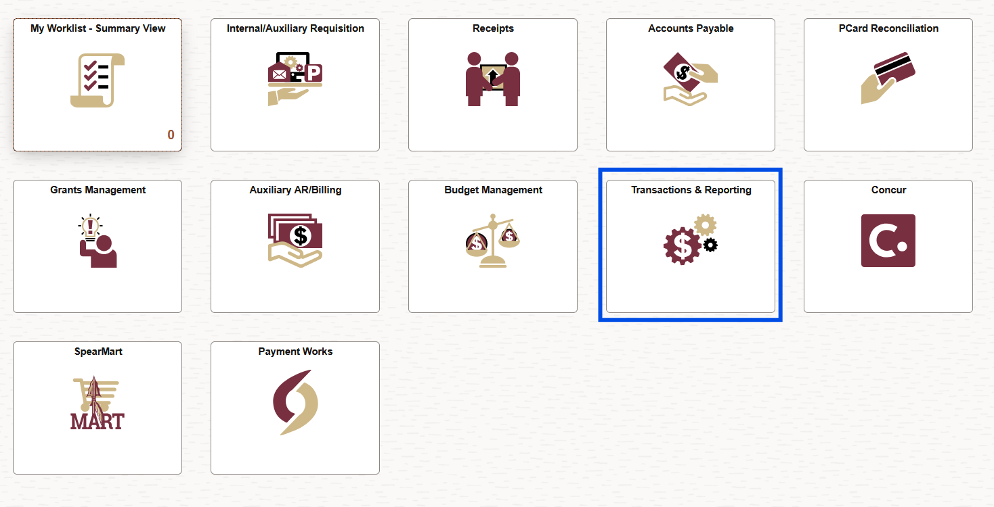
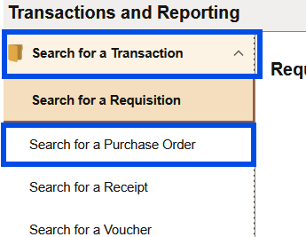
Procedures to Tell if an Invoice Has Paid Out
Next, go to ‘Transactions and Reporting’.
Then, click on ‘Search for a Purchase Order’, which is under ‘Search for a Transaction’.

Slide 6
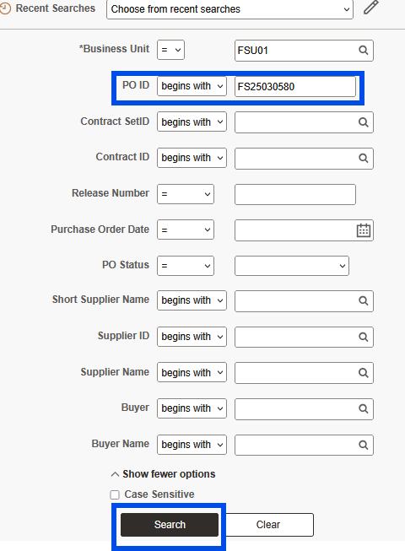
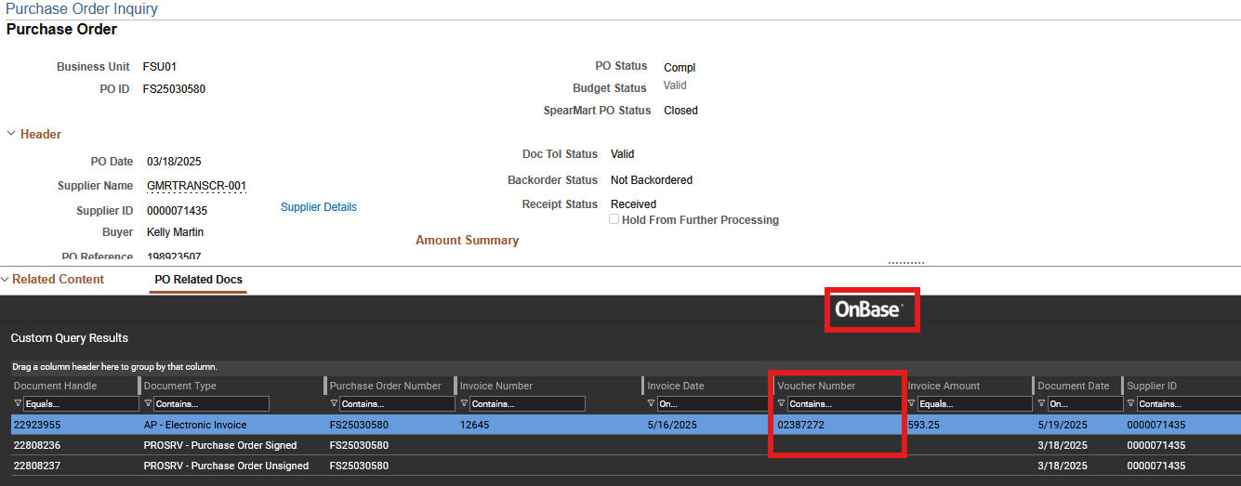
Procedures to Tell if an Invoice Has Paid Out
Input your Purchase Order (PO) number and click Search. Then, pull up OnBase at the bottom of the webpage. OnBase should list the invoice number, credit number, and/or voucher number. (Firefox and Edge is the recommended browser as the system does not like Chrome.)

Slide 7
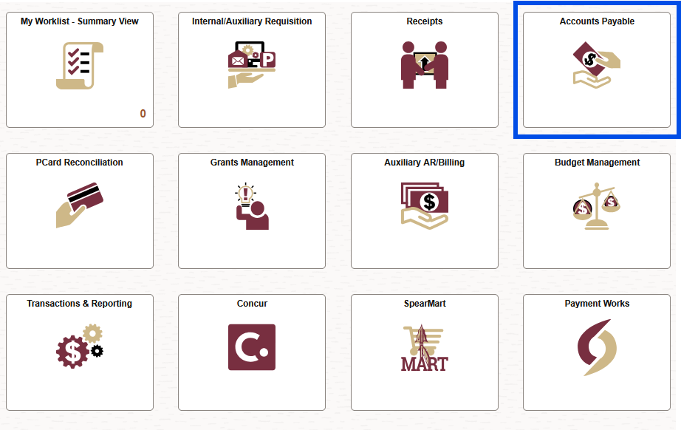
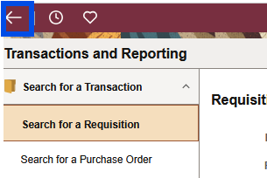
Procedures to Tell if an Invoice Has Paid Out
Copy or write down the number you need to look up (invoice, credit, or voucher number).
Then, click the back arrow in the top left corner of the webpage and click on the Accounts Payable tile.

Slide 8
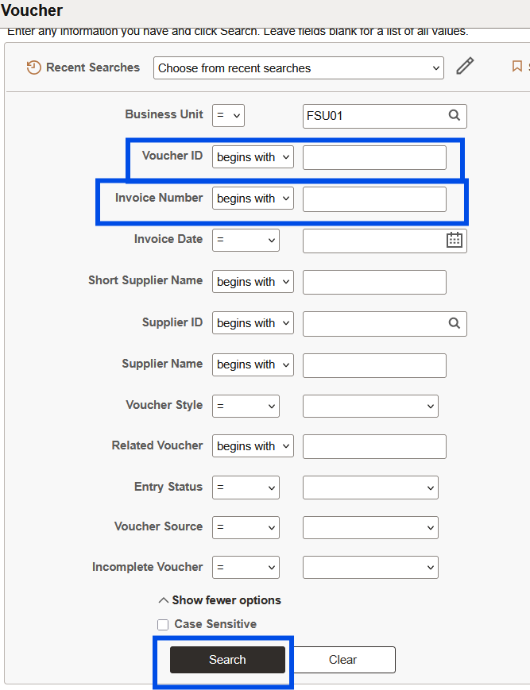
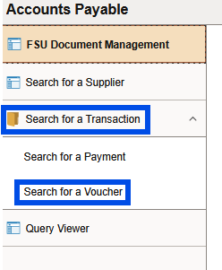
Procedures to Tell if an Invoice Has Paid Out
In the next screen, click on ‘Search for a Transaction’ to open up the tab. Then click ‘Search for a Voucher’. Next, input the voucher number in the box beside ‘Voucher ID’, the invoice number in the box beside ‘Invoice Number’, or if you have a credit, the credit number can be input into the box beside ‘Invoice Number’.

Slide 9
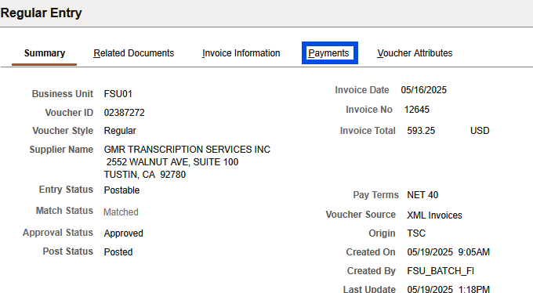
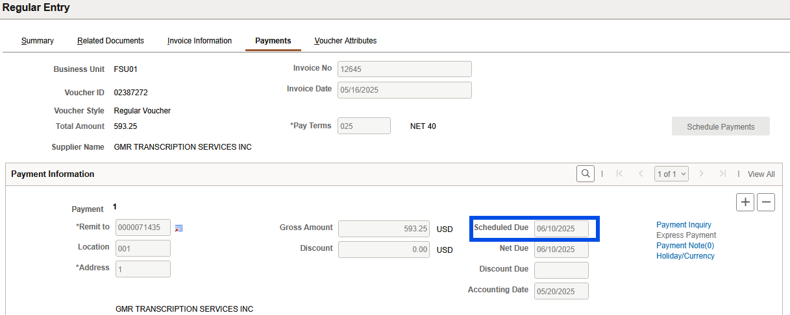
Procedures to Tell if an Invoice Has Paid Out
Then, click on the Payments tab and the Scheduled Date is the date that the voucher will pay out. Since the voucher searched had a scheduled due of 6/10/2025, a change order requesting closure of the PO can be submitted on 6/10/2025 or later as long as there are no other invoices expected for the PO.
​
​

Slide 10
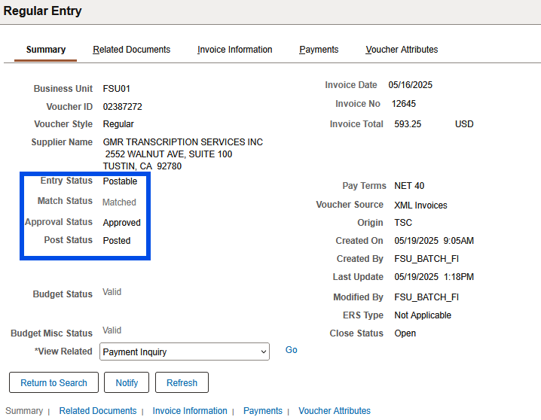
Other Guidance
Exception Status
The summary tab of the voucher will let you know the status of the voucher. Exception Status is when there is an issue with the invoice and/or voucher that is keeping it from being fully processed. If the voucher is in exception status, please reach out to Accounts Payable to work on the issue so that the voucher can be moved from exception status to approved status so that the voucher can pay out. ​
​

Slide 11
Other Guidance
It is the responsibility of the submitter to confirm that all receipts, invoices, credits, and vouchers are completed prior to submitting a change order to close a PO.
Receipts, invoices, and vouchers must be the same amount unless there is a credit. There should be a receipt for each invoice and only for items physically received, services performed, and/or invoices received.
A credit should be received and processed by Accounts Payable if an item was shipped but not received or was returned to the supplier and an invoice was processed for the item.
The payment date must be a date in the past as payment must be completed before a PO can be closed.
If a PO is closed and an invoice is received for that PO, a Confirming PO will need to be submitted to pay the invoice as an invoice cannot be processed against a closed PO.

Slide 12
Questions and Answers
Website: procurement.fsu.edu
Please contact changeorder@fsu.edu or at x46850 for additional assistance
Thank you for attending!

