Slide 1
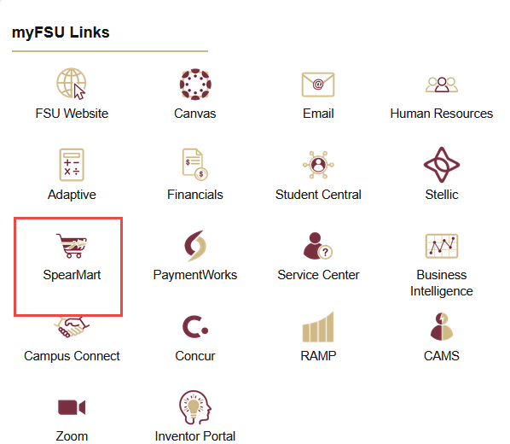
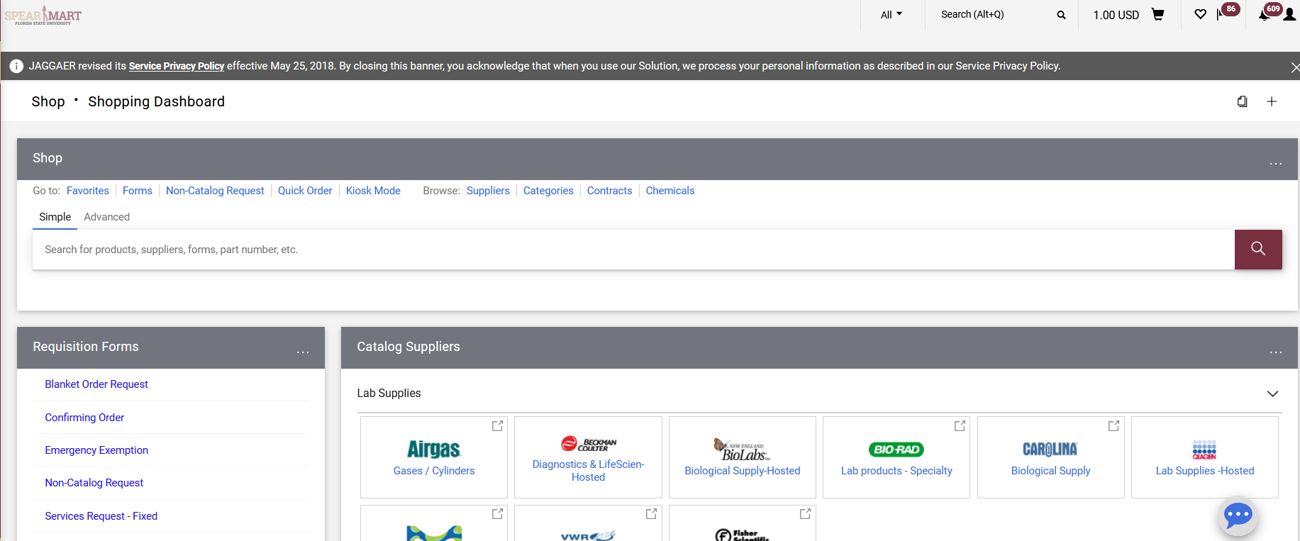
Change Requests: The Change Order Form Request is to be used when you need to make a change on a Purchase Order (PO) that has already been sent to the supplier. Prior to pulling up this form, you will need to go into OMNI and view the Purchase Order. You will need the supplier name, commodity code, budget information for each line that needs changing, and you must verify that there are no open receipts and/or payments pending on the PO prior to submitting the Change Order Request Form. If there are open receipts with no payment scheduled or made, you should cancel the receipt prior to processing the change request. If there are receipts and payments made, you can only do limited actions on the order/line.
Important Notes: Any line on a PO that has been partially or fully received and a payment has been made, cannot have any changes made on it.
Supplier name changes cannot be processed on a PO. You will need to cancel the order and start over if the wrong supplier was initially used.
Once you have this information gathered, now you can go to the form as follows:
Access SpearMart by navigating to https://my.fsu.edu/ and logging in with your MyFSU username and password, and then click the SpearMart Icon under MyFSU Links:
The SpearMart Home page will open.
The Change Order Form Request is found in the list of Forms on the left side of the main page. Simply scroll down until you see the list of forms.

Slide 2
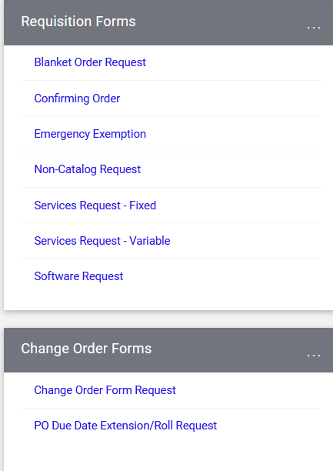
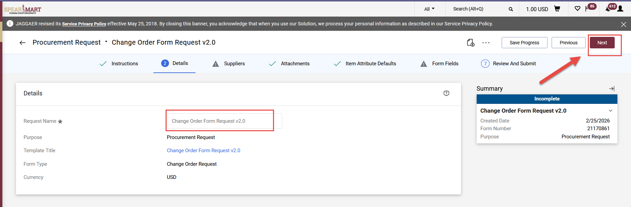
Select the “Change Order Form Request” form by clicking on the name of the form.
The form will open. We recommend that you add the PO number to the Form Name after the wording already in the name. Do not write over the name!
Click “Next” to continue.

Slide 3
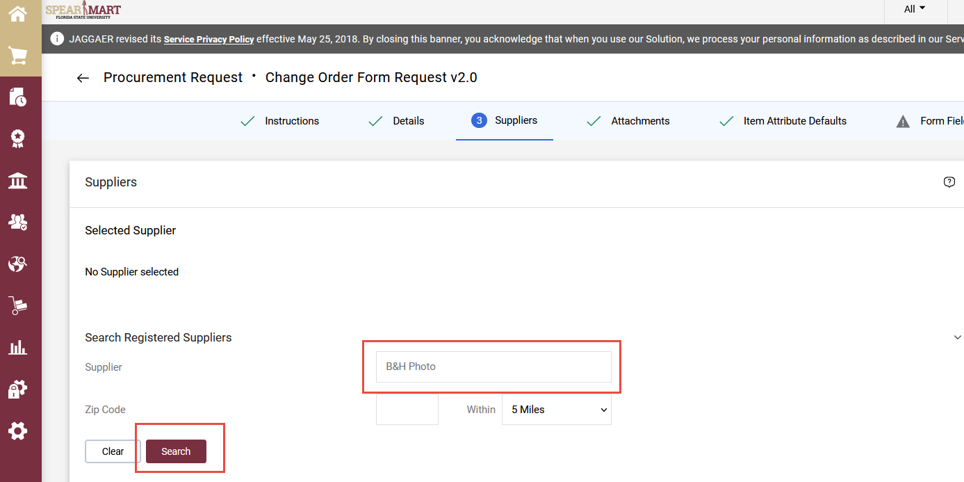
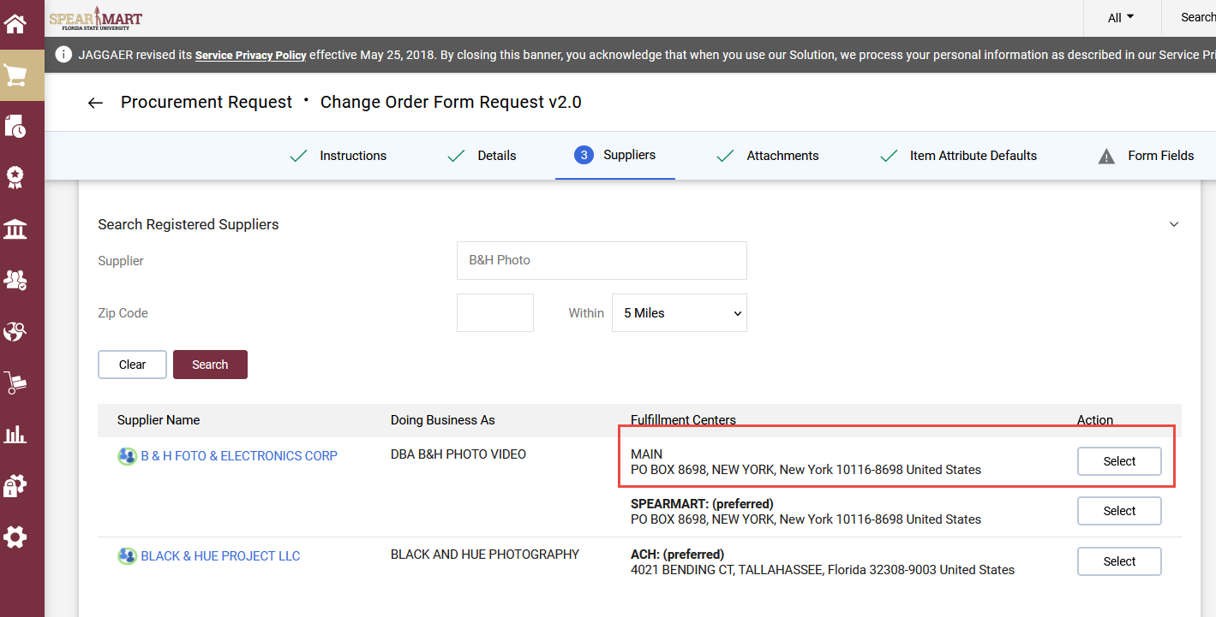
Enter the Supplier Name for the PO you want to make a change to in the “Supplier” field. Then click Search and select the correct address for the supplier.
The system will bring up all possible addresses for that supplier. Select the appropriate address.
Note: Do not select the SpearMart address, as that cannot be used with this form.

Slide 4
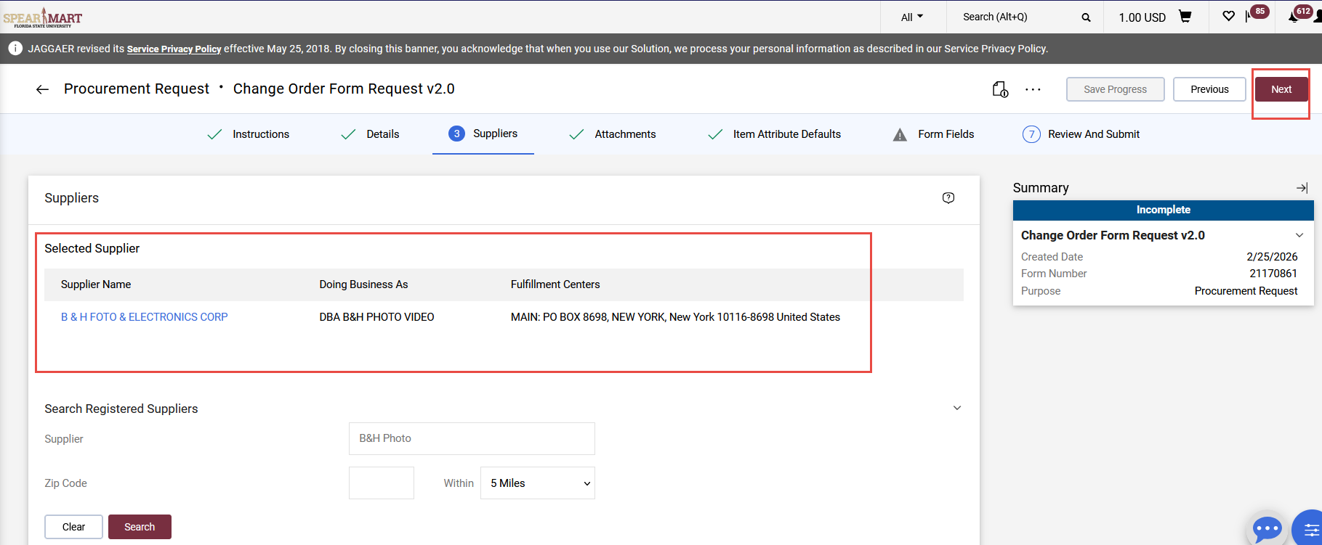
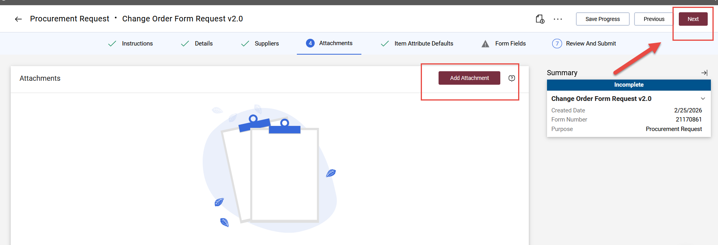
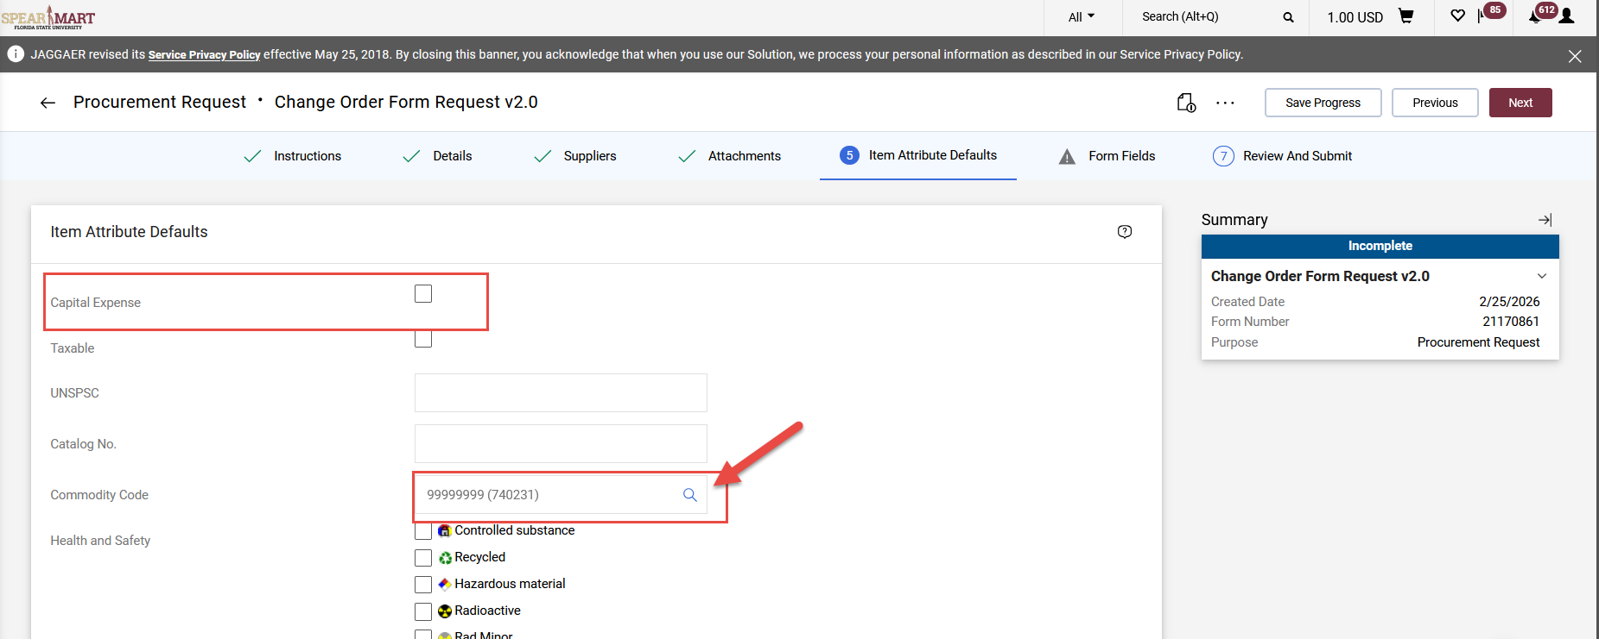
Once selected, the choice will appear. Click “Next” to continue.
The next step is to add attachments. If you have none to add, click “Next” to continue.
On the next step, you must update the default settings to “Yes” if the item is an OCO item. The only other item you will update is the Commodity Code. You must update this field with a valid code or the form will get returned to you.
To update, click the magnifying glass.

Slide 5
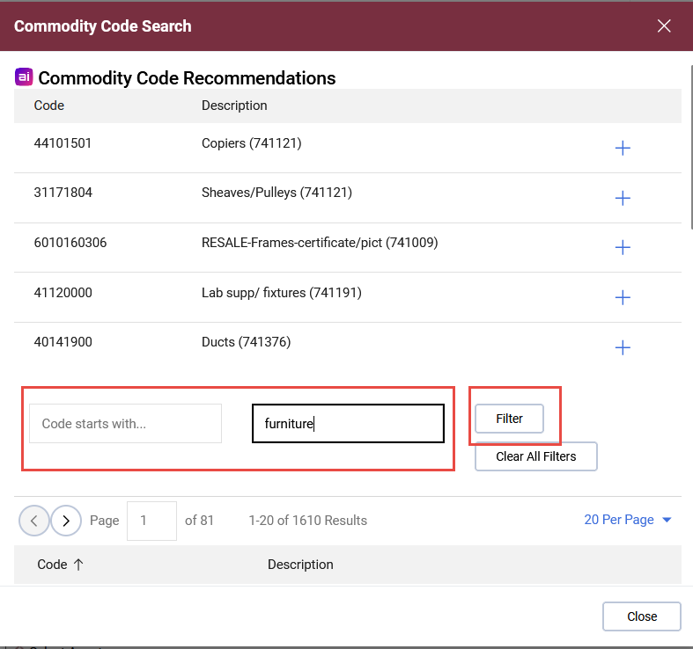
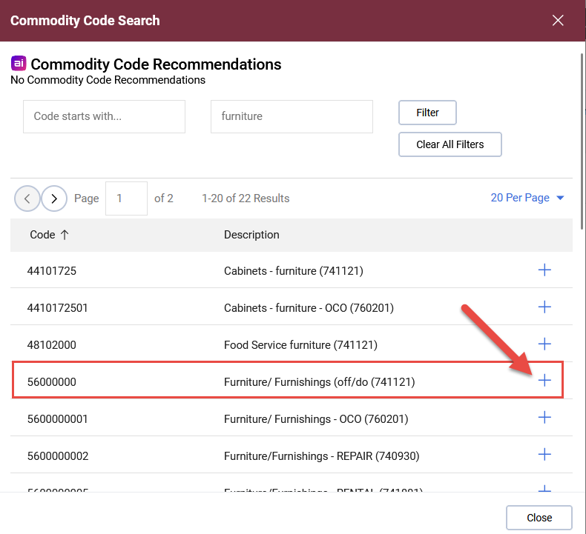
The search screen will pop up and you can enter the description for the commodity that matches the item being updated on the Purchase Order, or you can enter the commodity code. The click Filter.
Select the appropriate code and click the “+” sign

Slide 6
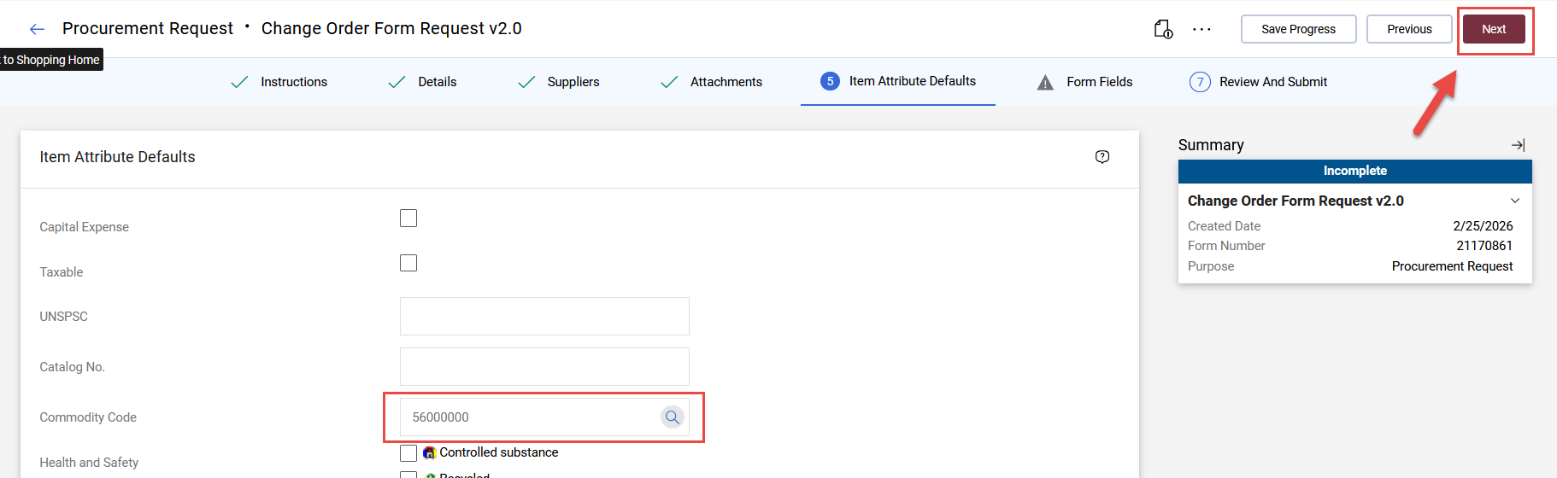
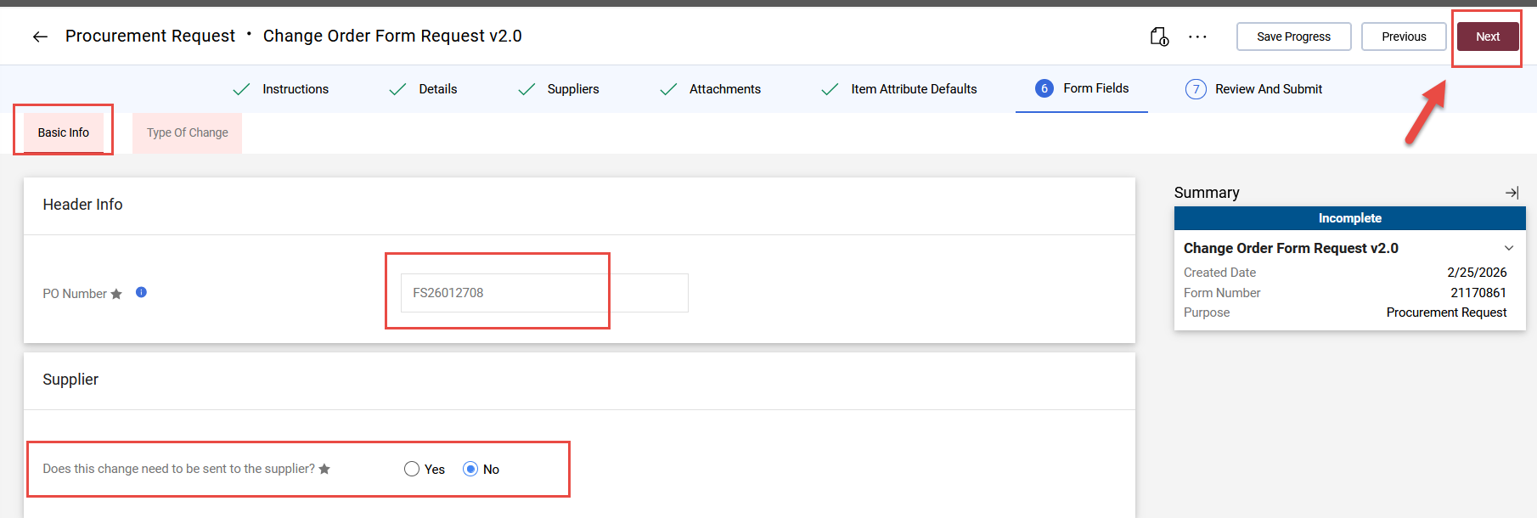
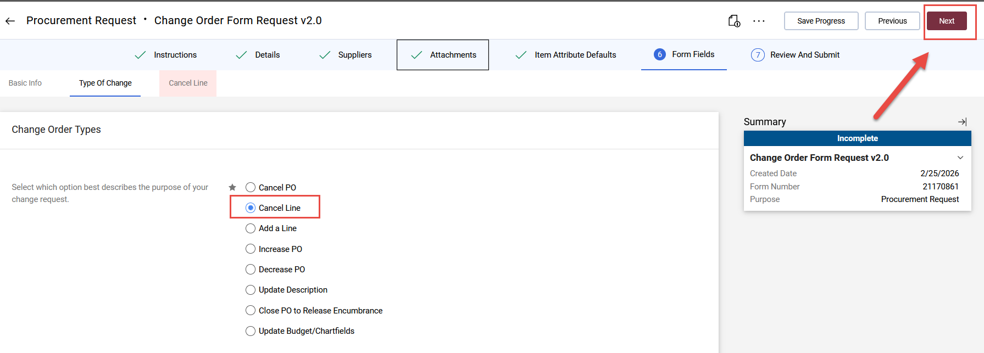
The commodity code selected will populate the page. Now you can click “Next”.
On the next page, you will see the “Basic info” tab. Enter the PO number in the field provided and select the appropriate choice whether to send the Change Order to the supplier or not. Then click Next.
Note: For SpearMart Catalog orders, we cannot send the change to the supplier, so always select “No”.
On this page, you will see the “Type of Change” tab. You will select the appropriate action/purpose of the change request. Once selected, each following page is a bit different, and you will have to fill in the fields appropriate to the choice made on this page.
For this example, “Cancel Line” is selected. Click Next:

Slide 7
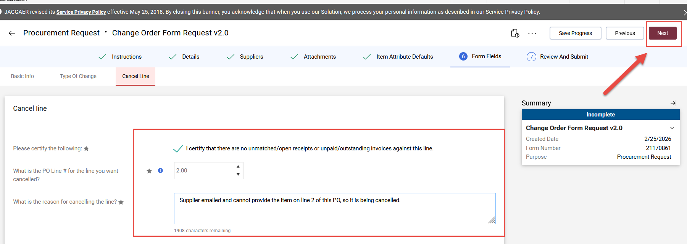
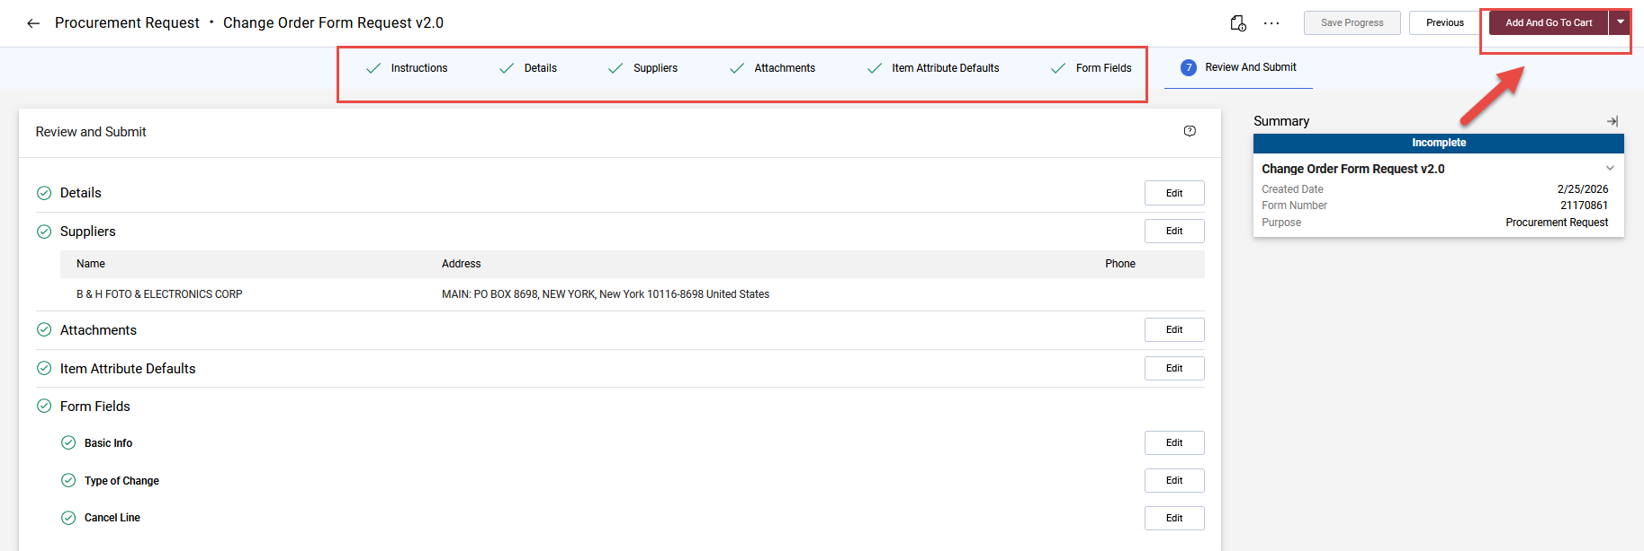
For increases, decreases or updating descriptions, you will need to make note of which PO line needs to updated. If multiple PO lines need to updated, a line for each will need to be created on the change order request form.
NOTE: If you are making a change to catalog order, a confirmation email from the supplier regarding the update must be attached with the change request.
You must click the certification statement. Prior to clicking this statement, you must go to OMNI, pull up the PO, and verify that no receipts and/or payments are pending for the line you want to cancel.
Important Note: If there are receipt(s), but no payments, cancel the receipt(s).* If there are receipt(s) and payment(s) for that line, you cannot cancel the line since the payment has been made. *See “Processing Receipts” Job Aid.
Once you get to the below page, all checkmarks should be green, and you can either click “Add and go to cart” if this is the only line on the PO to have any changes made to it OR click the arrow and get the other choices if more lines are needing changes. See below for the choices.
If more lines need changes for the same PO, then select “Add to Cart and Return”. Then fill in the change order request form for the next line. When all line changes are completed, then select “Add and go to cart”.

Slide 8
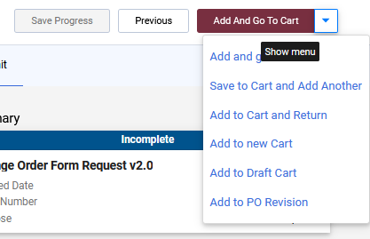
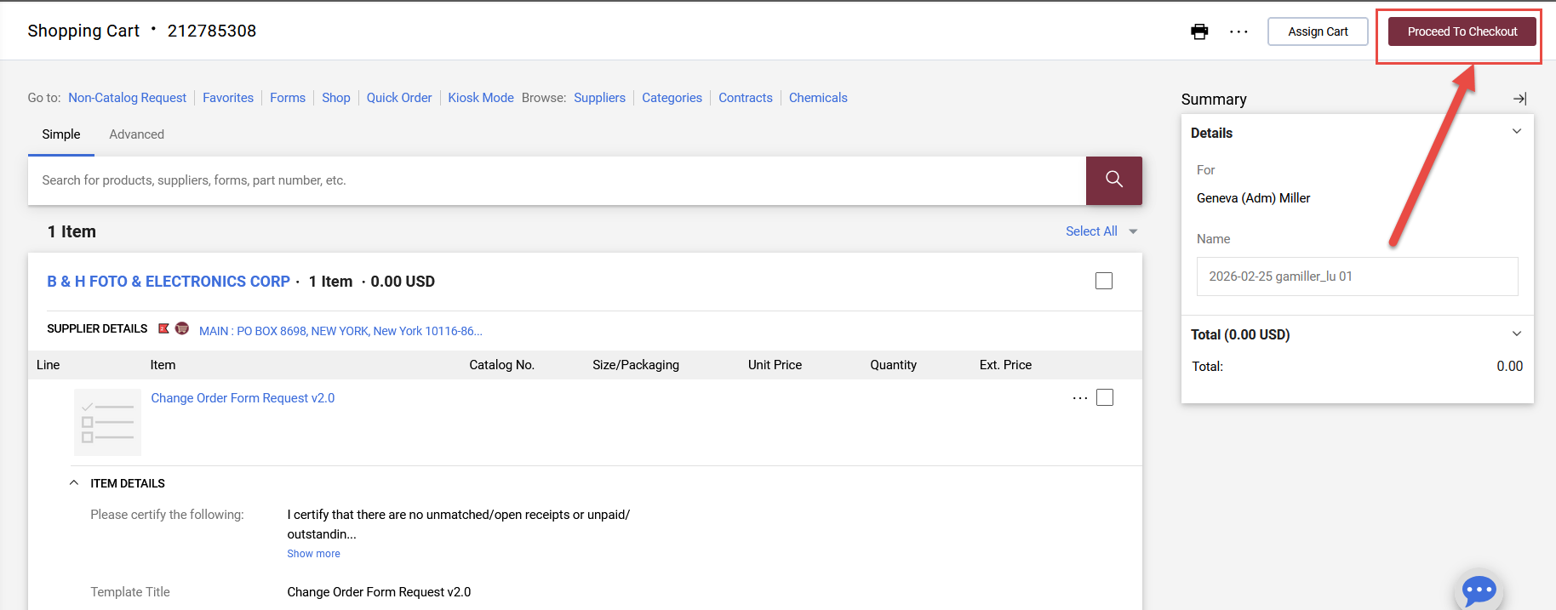
For this example, this is the only line that needs changes, so “Add and go to cart” was selected. The cart is now ready to either be assigned to a Requester or if you are a Requester, click “Proceed to Checkout” to continue.
Click “Assign Cart” or “Proceed to Checkout” depending on your role.
Note: If you need more information on how to assign or submit, see the Job Aids titled, “Assigning Your Shopping Cart” or “Complete a Requisition”.

