Slide 1
Uniform Guidance – Procurement of Goods or Services with Federal Grant Funding
Notes:
Good Afternoon! I’m Karen Gibson, Associate Director of Procurement Services and I’m going to go through some of the changes that have occurred within our federal procurement law as it related to sole source procurements. Keep in mind that this is not FSU Procurement mandated. This is mandated by the Federal Government and if we don’t follow the standards that they have set, it could not only result in fines to the University but there could be a loss of federally appropriated funding.

Slide 2
When purchasing goods or services, especially with federal funds, the purchase is subject to the Federal Uniform Guidance (UG) and University procurement procedures.
Notes:
The Office of Management and Budget (OMB) made several changes to the federal circulars – now known as Uniform Guidance (UG). These parts in 2 CFR 200 that contained purchasing changes became effective July 1, 2018 and the Procurement guidance is specifically located in sections 200.317 – 200.326.
This new guidance focuses on increased competition and transparency in the procurement process.

Slide 3
The UG procurement standards identifies three thresholds:
Micro-Purchase: Less than $25,000.00
Small Purchase: $25,000 - $149,999
Competitive Formal Solicitations: $150,000 or more
Notes:
UG has categorized into different dollar thresholds which indicate how we have to follow guidelines for making purchases.
For the micro-purchase threshold which is less than $25K there are no changes from our current practices for purchasing goods under $25K as the new UG threshold matches the current FSU threshold for micro-purchases.
For Small purchases and purchases that are $25K and up, this is where we have stricter guidance to follow, especially when it comes to sole sources and competitive bids.

Slide 4
Micro-Purchase Threshold (Less than $25,000)
Purchases under the Micro-Purchase Threshold can be awarded “without soliciting competitive quotations” if the price is reasonable. For purchases under $25,000, following University guidelines should be sufficient.
Notes:
Micro-Purchases – these are less then $25K and typically don’t require competitive quotes and most of these, if the purchase is reasonable go right through without much intervention.

Slide 5
Small Purchase threshold ($25,000 - $149,999)
Competitive written quotes are required. Submit specifications and any quote documentation with your requisition through SpearMart.
Notes:
For purchases that are $25K and up to $149,999 – this is our threshold for obtaining written competitive pricing (i.e. written quotes). And I’ll get into UG requirements further into this presentation.

Slide 6
Competitive Formal Solicitation Threshold ($150,000 and up)
Purchases that exceed the Competitive Formal Solicitation Threshold, $150,000 or more, are subject to strict procurement requirements. In order to comply with federal requirements it is essential that purchasers plan significantly in advance of purchase as the Bid, ITN or or Sole Source process can take several weeks.
Notes:
And then $150K and up requires that we go out for formal solicitation (i.e. Invitation to Bid, Invitation to Negotiate or sole soucre, etc.). Per our BOG Regulations we are required to have a formal “Procurement Method” and according to UG, there are strict requirements when planning and soliciting that we have to follow, especially when using federal funds.

Slide 7
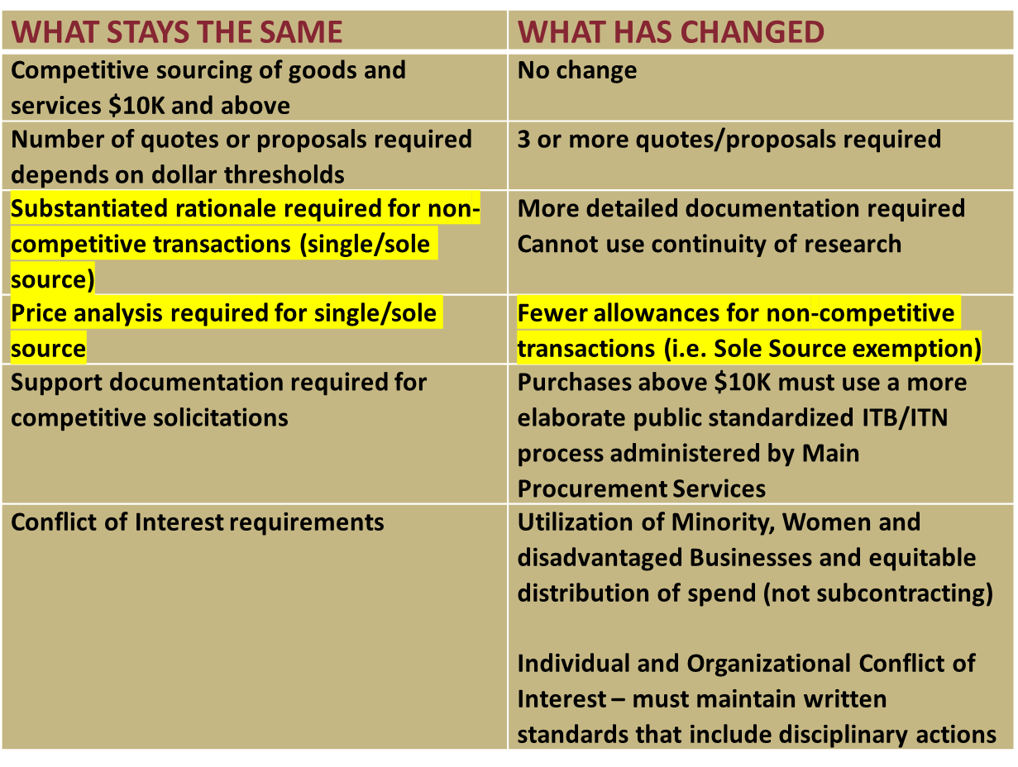
Notes:
This slide gives you a summary of what stays the same vs. what has changed.
Currently we still need a substantiated rationale for non-competitive transactions (like sole sources) and a price analysis is required for single or sole source purchases, which Procurement always perform on these transactions.
On the changes you’ll notice that UG requires:
More detailed documentation
And the most significant change to the sole source section of UG is that “continuity of research” is no longer an acceptable justification for sole source approval so there are fewer allowances for non-competitive transactions or sole source exemptions. There must be a more deliberate attempt at researching/screening and documenting a fair and reasonable price and obtaining a cost price analysis.

Slide 8
How will this impact me?
Additional effort will be required for purchases $25K and over and especially $150K and up due to UG public competitive requirements
Transactions will require feedback from subject matter experts (researchers, PI’s, etc.) to document solicitations
UG documentation requirements are generally more significant
Notes:
So How will this impact you?
Again, there will be additional requirements that we are required to follow according to the Fed’s which I’ll go into more detail in the next few slides as again it’s all about competition, transparency, and saving money so Procurement will typically work more closely with PI’s and Researchers to obtain more information and feedback for documentation and solicitation requirements.

Slide 9
UG Procurement Requirements
Procurement may execute formal sourcing event (ITB or ITN)
Your procurement Category Manager will obtain specifications or scope of work from you and handle this through SpearMart and notify suppliers.
Notes:
If $150K or greater, procurement may perform a competitive bidding process. Product and service requirements would be submitted to the Procurement department, which will conduct the bidding in conjunction with key stakeholders within the department.

Slide 10
UG Procurement Requirements
- Solicit from an “adequate” number of qualified sources.
Conduct technical evaluations of the proposals and select recipients.
Award the contract through price analysis to a reasonable firm whose proposal is most advantageous (price and other factors should be considered, not just low-bid).
Notes:
Under UG procurement standards, they want to make sure that we are reaching out to a suitable or sufficient number of sources and that we are providing them with sufficient time to respond – whey want competition. With any competitive procurement they want to ensure that we have conducted an evaluation of all proposals to select the best qualified and cost efficient supplier. But before we make the award, they want to make sure we have conducted a price analysis (benchmarked pricing and other factors) to mitigate risk and ensure a fair and reasonable price.

Slide 11
Examples considered restrictive of competition:
Requiring unnecessary experience
Noncompetitive pricing practices between firms or affiliated companies
Noncompetitive contracts to consultants
Specifying only a brand name product instead of allowing an equal product and describing performance or other relevant requirements
Notes:
Things we don’t want to do is try to put through a request by restricting competition. Here are a few examples:
Requiring unnecessary or unneeded experience
Where companies collude to set prices or giving one company an unfair competitive advantage over others.
Consulting contracts are almost never a sole source. There may be a few instances but normally we need to seek competition on these.
One company may offer a particular brand name product, but that doesn’t necessarily mean that another company can’t offer something similar or the same under a different brand name. Thus we really need to be focusing on the performance or requirements of what we need when writing specs.

Slide 12
Non-Competitive Proposals
All purchases over $25,000 have a competitive solicitation requirement under the UG.
If purchase is $150,000+ and you believe to be a true sole source, you must submit a Sole Source Justification (this is for all funds (federal grant and non-federal grant).
Notes:
Anything between $25K and up to $149,999 requires that we seek competition through a request for quote process (we must obtain written quotes) or we must have some other procurement method such as a sole source or we are utilizing another competitive solicited contract through another govt. or university entity that was competitively solicited, awarded and is still ongoing and the specifications or the scope of work is the same as what we are looking for.
If $150K and greater, and you feel it’s a sole source you can provide us with a justification through the SpearMart Sole Source Requisition form and we can review it. Again, regardless of source of funds, the federal procurement standards require that we follow and perform particular actions especially when it comes to sole sources.

Slide 13
Situations which are allowable for Sole Source procurement include:
Available only from a single source
The Federal awarding entity or pass-through entity expressly authorizes non-competitive proposals
Public exigency or emergency for the requirement will not permit a delay resulting from competitive solicitation
After a formal competitive solicitation, contacting a number of sources, competition is deemed inadequate
Note: Sponsored Research Exemption (SRE) is not a recognized allowable procurement under UG for federal funded projects.
Notes:
Uniform Guidance (UG) has limited the use of sole sources to four (4) distinct justifications:
Product/service is only available from a single source (if supplier went out of business you would not be able to obtain).
Federal Awarding Agency authorizes: they specifically authorized a non-competitive procurement after a written request from FSU (the non federal entity). Principal Investigators should contact the SRA team for guidance and assistance in making requests to sponsors to help determine if it was expressly authorized).
Public Emergency which affects the health, safety and welfare of students, campus or others. (i.e. if there was an explosion in a lab – we wouldn’t have time to see quotes or bids – we’d have to take action and procure immediately).
Inadequate competition after solicitation of multiple sources.
A Word of Note: When Using Federal Funds, UG doesn’t recognize an SRE Exemption as one of the mentioned sole source justifications that I just spoke about. SRE may be utilized if you have other grant funding that’s not federal.

Slide 14
UG Requirements for Federal Funds - Contract Cost and Price (200.323)
Must make independent estimates before receiving bids or proposals.
Procurement must negotiate profit as a separate element of the price for each contract in which there is no price competition and in all cases where cost analysis is performed
Notes:
Earlier I mentioned that before issuing a formal solicitation and obtaining quotes or proposals and before obtaining a quote or proposal for a sole source, we need the dept., researcher or PI to provide an independent cost estimate. Again, this can be done by viewing information published or on the web, existing contracts, talking to peers, etc.
In addition, UG says that Procurement must negotiate profit as a separate element of the price for contracts where there is no competition (i.e. sole source). Thus Procurement will take the information from the proposal and cost analysis performed and go back to the supplier and further negotiate on the cost. This all has to be documented for the procurement record and it can take a little time.

Slide 15
Sole Source Purchases – Cost Analysis
Under the new UG Procurement Standards, any sole source purchase $150,000 or greater must be accompanied by a cost analysis that includes all costs that lead to the quoted price. As this cost analysis would need to include line items for overhead and profit, it is highly unlikely that a supplier would provide this information. However, if you are able to acquire this, include it with the Sole Source Justification. The Procurement Category Manager will need to conduct a cost analysis of the “reasonableness of each cost element.”
Notes:
Every sole source requires a price/cost analysis justification to show that the University is receiving a fair and reasonable price. Procurement always performs this by contacting the supplier and also performing benchmarking with our best in class peers. Again, this is a federal requirement.
This is why we try to get the supplier to breakdown their costs on everything – to determine profit and further negotiate savings. And this is why performing benchmarking helps.

Slide 16
Exceptions to Competitive Formal Solicitations and Sole Source Requirements
The UG allows for “piggybacking” off of existing contracts that were competitively solicited. Procurement can research to determine if there is a public contract, such as those with a government (federal, state, county, city, etc.) or a cooperative entity (E&I, U.S. Communities, NJPA, State of Florida, other University, etc.).
Notes:
As I stated earlier the UG allows for piggybacking on existing contracts, however, we do caution that if the scope of work or specs are not in line with what we are wanting to do or obtain then the contract may not be usable. We do get auditing on making sure the contract is actually in scope, that we are not paying more than the Master Contract and that it’s in the best interest of the University.
We actually had a University here in Florida that got audited on this and our Board of Governors (BOG) started looking more closely at how everyone in the SUS was piggybacking contracts.

Slide 17
UG Requirements for Federal Funds - Concerning Equipment Use (200.313(2))
During the time that equipment is used on the project…for which it was acquired…must also make equipment available for use on other projects…currently or previously supported by the Federal government… provided use will not interfere with the work on the projects for which it was originally acquired…
Notes:
Section 200.312 (2) focuses on equipment use:
The terms and conditions of sponsored awards may have specific requirements for the acquisition of equipment, such as the National Science Foundation, which requires that before equipment is purchased the grantee assures the same or similar equipment is not otherwise reasonably available and accessible. Further, 2 CFR OMB Part 200 Uniform Guidance lays out the requirements for equipment purchases with federal funds. The rationale for these regulations is that shared use of existing equipment promotes availability of equipment on university campuses, reduces unnecessary duplication of equipment, and frees up federal funds to further the aims and objectives of the award. The fed’s want to make sure that you don’t already have access to available equipment instead of purchasing more. They want you to look at things like surplus property or other departments/labs to determine if you can share equipment to save money. With the Fed’s it’s all about saving money.

Slide 18
UG Requirements for Federal Funds - Supplies (200.314(a))
The non-Federal entity must retain the supplies for use on other activities or sell them, but must, in either case, compensate the Federal government for its share.
Notes:
For section 200.314 the fed’s are saying that if you don’t use up all the supplies that they provided you money to purchase, you can either use them on other activities or projects or you can sell them, but in either case, you must compensate the federal government back for their share if they weren’t used on the project they gave you funding for.

Slide 19
UG Requirements for Federal Funds -Procurement of recovered materials (200.322)
Must comply with section 6002 of the Solid Waste Disposal Act, as amended by the Resource Conservation and Recovery Act.
Notes:
Section 200.322 – Procurement of Recovered Materials:
This is a new requirement and applies to every fund not just federal funds. This usually includes goods that are typically procured as recycled (i.e. paper), for other goods that can be normally procured as recycled, or for recycling/waste services.
For transactions that exceed $10K or for contracts where the value of items purchased in the prior year exceeded $10K, we would review the requirements to utilize recovered materials at the highest percentage possible while maintaining a satisfactory level of competition.

Slide 20
UG Requirements for Federal Funds -Contracting with small and minority businesses, women’s business enterprises, and labor surplus firms (200.321)
The non-Federal entity must take all necessary affirmative steps to assure that minority businesses, women’s business enterprises, and labor surplus area firms are used when possible.
Notes:
Section 200.321 says we must make affirmative efforts to solicit from small, minority, business enterprises whenever possible so we would want to include any potential firms on the list of suppliers contacted for proposals and we must document that.

Slide 21
UG Requirements - Procurement Records (200.318(i))
The University must maintain records sufficient to detail the history of procurement. These records will include:
Rationale for the method of procurement
Selection of contract type
Contractor selection or rejection
Basis for the contract price
Suspension and debarment checks
Notes:
Section 200.318 says under UG we must maintain records sufficient to detail the history of the procurement and document all actions. This includes the rationale (why we chose they type of procurement method – i.e. ITB vs. ITN vs. Sole Source, etc.);
They type of contract we decided to award;
Our basis for contractor or firm selected or reason why we rejected a contractor or firm;
How we came to the price that we felt was reasonable and in the best interest of the university; and
Whether procurement performed any checks to determine if a supplier has been suspended or debared from doing business with the state and university or even the federal government.

Slide 22
UG Conflicts of Interest Policy
As part of the OMB’s Uniform Guidance, there are new requirements for conflicts of interest and how the University must handle them. The regulation states:
“No employee, officer, or agent may participate in the selection, award, or administration of a contract supported by a Federal award if he or she has a real or apparent conflict of interest. Such a conflict of interest would arise when the employee, officer, or agent, any member of his or her immediate family, his or her partner, or an organization which employs or is about to employ any of the parties indicated herein, has a financial or other interest in or a tangible personal benefit from a firm considered for a contract.”
Notes:
Also, as part of UG there are Conflict of Interest requirements.
Conflict of Interest requires increased disclosure of documentation for potential committee members. Currently for ITN’s we obtain committee member certifications to ensure there are no conflicts of Interest, However, sole source justifications may require further evidence or statements assuring that no financial relationship exists with potential suppliers. With UG they want to make sure there isn’t any individual or organizational conflicts of interest.

Slide 23
Examples: When Not a Sole Source
A supplier’s characterization that they offer “The Best” (service, support, warranty, etc.)
Incumbancy does not justify a sole source procurement.
A desire to contract with a favored supplier for a favored good/service.
Cannot be based on a previously non-competitively bid contract.
Notes:
These are just examples of when something is not deemed a sole source.
We normally never take the supplier’s word for it as we are required to research to ensure something is a true sole source.
Just because we are currently using a particular supplier doesn’t mean we should bypass or exclude competition and keep using the same supplier.
We understand that sometimes we really like a supplier and would like to continue using them, but again, we are required to seek competition and we would encourage that supplier to compete like everyone else.
Just because a supplier had a bid award doesn’t mean they will be the same supplier the next time around. The market for competition may change or pricing changes and so again it’s all about seeking competition.

Slide 24
Examples: When Not a Sole Source
A proprietary solution where multiple suppliers or distributors may provide the technology goods and/or services required for the solution.
Continuity of Research
Notes:
If there are multiple suppliers or distributors then we should be seeking competition.
We can’t just say it has to be compatible with current equipment. If we seek competition and there is only one supplier that can respond or we can provide detailed documentation as to what makes it so unique that no other supplier can provide then we may be able to deem it as a sole source. Something to remember is if that supplier were to go out of business tomorrow, would you still be able to obtain that product or service elsewhere or something similar that would still meet your needs. If so, then it’s not really a sole source.

Slide 25
Scenario #1
Question: I want to sole source a consultant for academic research. I have a strong professional relationship with the individual and the person is familiar with my work. He/She is also the top expert in their field. Is this a sole source?
Notes:
Answer: Typically, this is NOT going to be a sole source because it is nearly impossible to justify that one person is the ONLY person in the world that can perform the requested service. Most of the time, the best that can be justified is that they are “best” qualified, which is not a legitimate sole source justification. However, if an individual is REQUIRED based on qualifications they have, a sole source may be justified. The key to a successful justification is to explain in detail the required qualifications – why we need someone with that specific qualification and how we know this is the only person with this qualification.
Note: Often times a competitive solicitation is a better option and its quicker.

Slide 26
Scenario #2
Question: I found a good/service with an unbeatable price from a world-class supplier. It is 30% cheaper than anywhere else. Is this a viable sole source?
Notes:
Under UG the answer: No. Price is never a justification for a sole source. If under $150,000 you can obtain 2 other quotes, if the value is $150,000 or greater a formal competitive solicitation will need to be issued.

Slide 27
Scenario #3
Question: What if I name a specific supplier in my proposal and the proposal is accepted? Is that justification for a sole source?
Notes:
Based on just that info the answer: No, The UG exemption requires two (2) things: both (1) a written request by the grantee for a noncompetitive purchase, and (2) for the funding agency to “expressly authorize” approval of that request. A simple approval of a proposal without any expressed approval, and no mention of the non-competitive procurement in the proposal does not fit that criteria. So it has to be expressly authorized by the funding agency.

Slide 28
Scenario #4
Question: What if a specific (named) vendor/consultant is included in the proposal and the request for a sole source exemption is stated clearly in the budget justification of the proposal, and the federal funding agency accepts the proposal, would that be a legitimate sole source justification?
Notes:
Answer: Maybe - At present, should there be such an exemption sought, a specific request (outside of the proposal) must be completed securing permission from the funding agency which will reference the documentation that was in the proposal as part of the exception. We would advise that guidance is sought through SRA on this.

Slide 29
Scenario #5
Question: I have been using this good/service for the last 10 years. I still need it for my research. Others could supply the necessary goods/service, but all of my research has this media/product and changing suppliers could disrupt my research or previous work product results. Is this a viable sole source?
Notes:
Answer: For Federally funded projects, continuity of research is not a justification for sole source.
If it’s not federal funded its possible we could deem it as a sole source or maybe a sponsored research exemption, etc. depending on justification/documentation submitted.

Slide 30
Questions?
Contact Procurement Services at 644-6850 or go to: www.procurement.fsu.edu
Notes:
Any Questions?

