Slide 1
Monthly P-Card Reconciliation
Job Aid

Slide 2
Monthly P-Card Reconciliation
Each month, the Proxy is required to complete the P-Card Reconciliation Form for each of their Cardholders and have that form signed by the appropriate individuals in the department to ensure the p-card is being used appropriately and certify that the charges are for business use and are providing a benefit to the University.
For more information on the P-Card program visit http://procurement.fsu.edu/
This job aid details the steps required to complete the monthly P-Card Reconciliation Form for cardholders.
Notes:
The FSU P-Card program was implemented in 1998 to facilitate departments in purchasing small dollar commodities and reduce the time for these purchases. Deans/Directors/Department Heads determine who is eligible to obtain a P-Card and those assigned to proxy charges for the cardholders in their departments. P-Cards are to be issued to only USPS, A&P, and long term OPS FSU employees. The cards are issued by Bank of America to employees that are certified and approved by their management and Procurement Services.
The P-Card works just like a regular VISA credit card. It is fast and easy, no waiting for a purchase order to be processed. Vendors are paid within 72 hours of the purchase. There is paperwork that cardholders must maintain and provide to their proxies as backup for these charges.

Slide 3
Completing a P-Card Reconciliation Form
Key Information Required:
Cardholder Employee ID
Cardholder Receipts
Note: You must already be enrolled in the Purchasing Card Program to gain access to the reconciliation documents. To enroll go to: Enrolling in the Purchasing Card Blackboard Site Job Aid to enroll.
Once enrolled, log into myFSU
Select the Blackboard icon
Click Courses and Orgs Tab at the top of the page.
Notes:
The FSU P-Card program was implemented in 1998 to facilitate departments in purchasing small dollar commodities and reduce the time for these purchases. Deans/Directors/Department Heads determine who is eligible to obtain a P-Card and those assigned to proxy charges for the cardholders in their departments. P-Cards are to be issued to only USPS, A&P, and long term OPS FSU employees. The cards are issued by Bank of America to employees that are certified and approved by their management and Procurement Services.
The P-Card works just like a regular VISA credit card. It is fast and easy, no waiting for a purchase order to be processed. Vendors are paid within 72 hours of the purchase. There is paperwork that cardholders must maintain and provide to their proxies as backup for these charges.

Slide 4
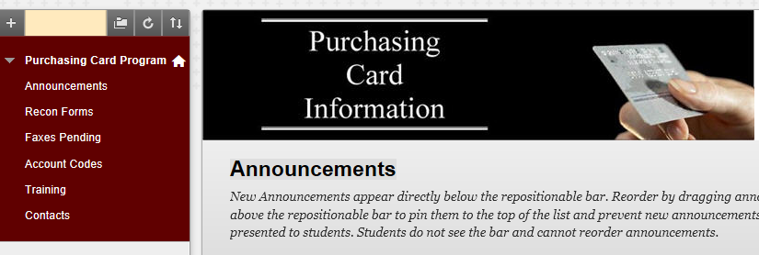
Completing a P-Card Reconciliation Form
Select “Purchasing Card Program” from the list of Organizations.
Click “Recon Forms” from the list.

Slide 5
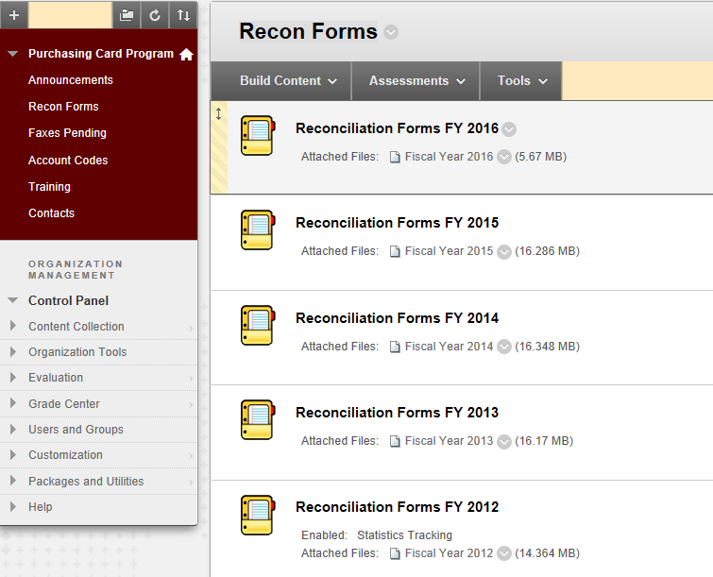
Completing a P-Card Reconciliation Form
The page opens up with all the different Fiscal Years (FY) listed.
Select the FY that corresponds to the one you are reconciling.

Slide 6
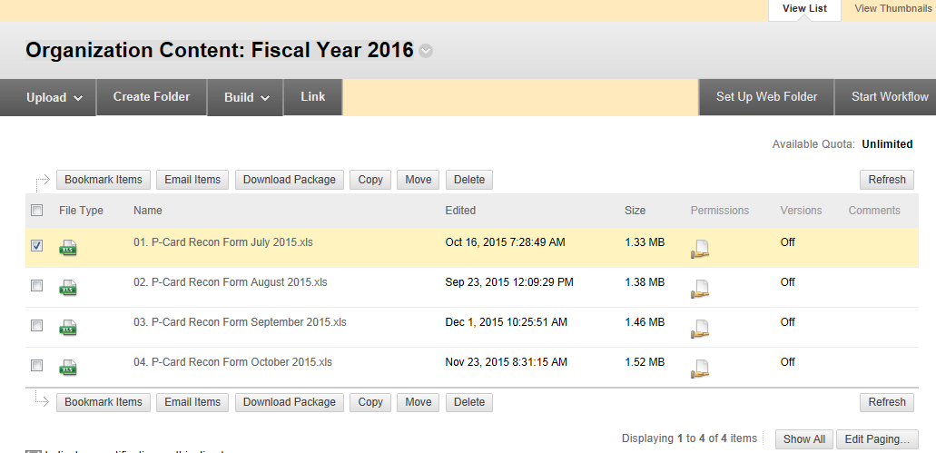
Completing a P-Card Reconciliation Form
Select the month you are reconciling by clicking the link.

Slide 7
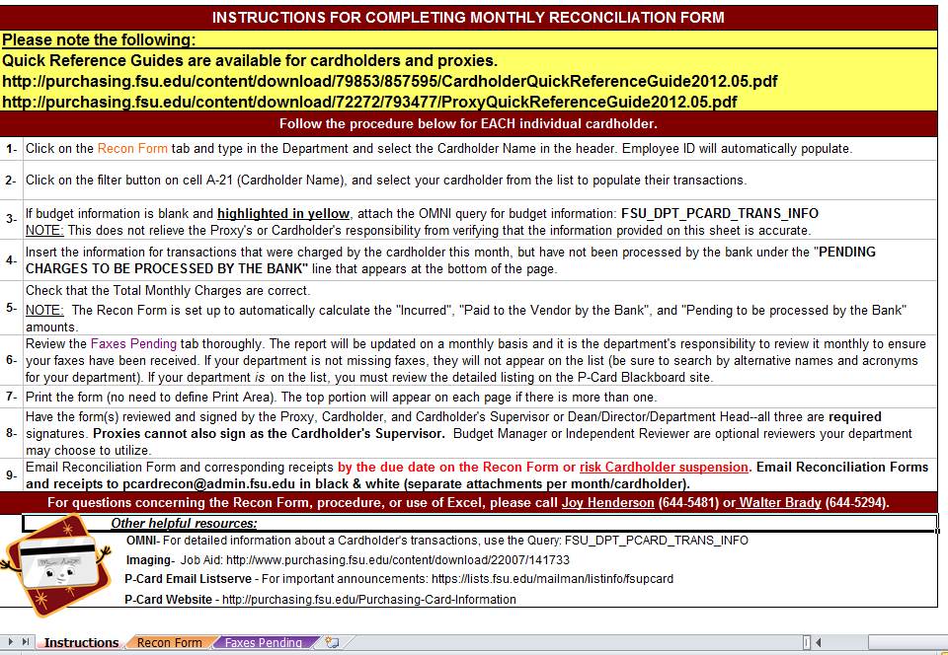
Completing a P-Card Reconciliation Form
Select the “Recon Form” tab at the bottom of the instruction page.

Slide 8
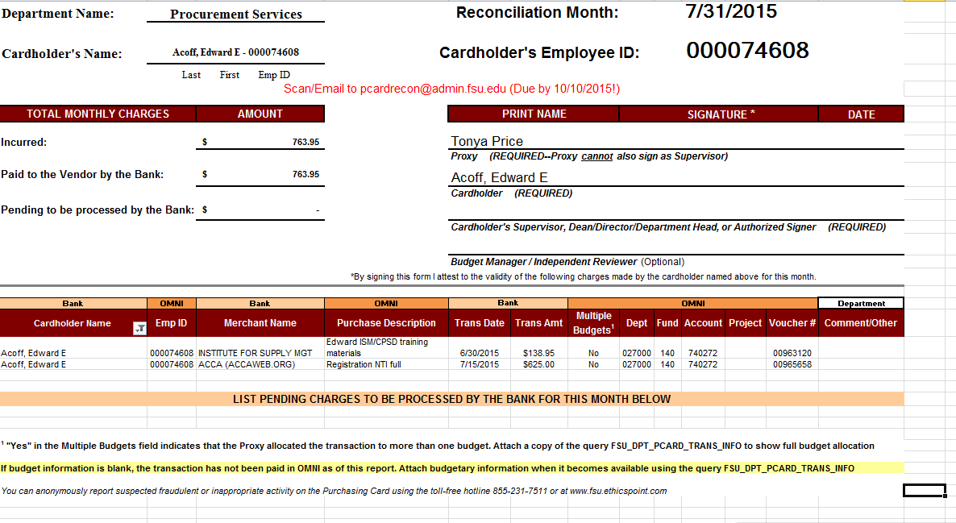
Completing a P-Card Reconciliation Form
Enter your department's name into the Department Name field.
Click arrow to the right of the Cardholder Name field.
Select your cardholder's name.
Go to the Cardholder Name field below and click the filter button for the Cardholder Name list. Unselect the “Select All” and then find your cardholder’s name and select it, click “OK”.
The cardholder name and their charges will populate the form.
Enter the Proxy and supervisor’s names in the appropriate places manually.

Slide 9
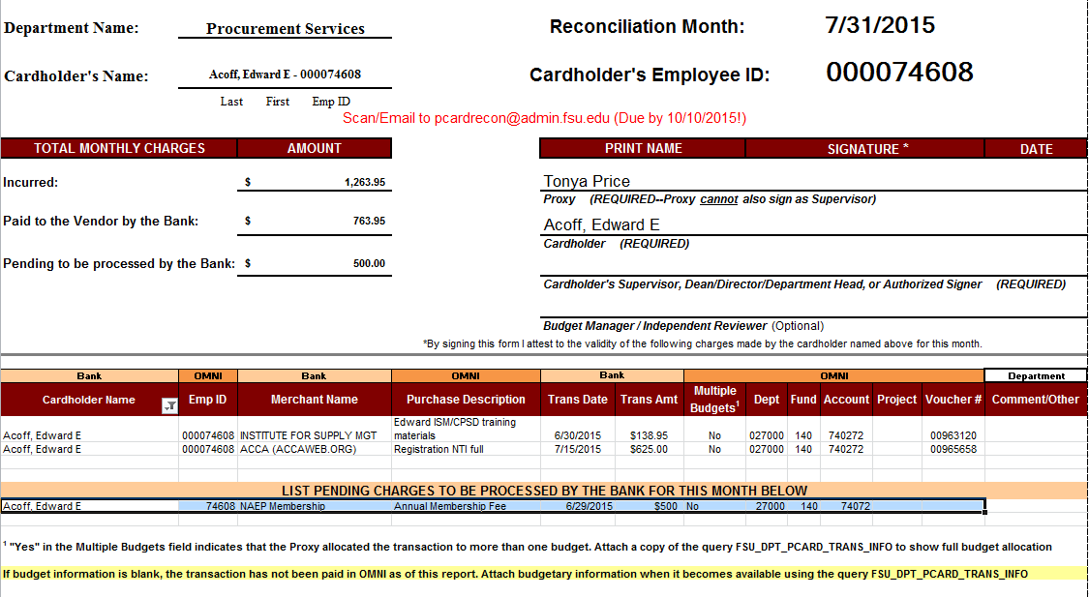
Completing a P-Card Reconciliation Form
Review all the transaction information for accuracy. Check the following:
Merchant
Description input in OMNI by Proxy
Transaction Date
Transaction Amount
Budget Information
If you need to change a budget on a particular charge, please submit the Expenditure Journal Transfer Form to General Accounting.
Check the Multiple Budgets column for your cardholder's transactions.
If there is a Yes, scroll down to the footnotes of the Reconciliation Form and take further action for the transaction. This will be explained on the next slide.
If you see a transaction that contains no budget information, you must scroll down to the footnotes of the Reconciliation Form and take the outlined further action for the transaction.

Slide 10
Completing a P-Card Reconciliation Form
A "Yes" in the Multiple Budgets column indicates the transaction was allocated to multiple budgets and the full budget allocation cannot be displayed on the Reconciliation Form.
In order to show the full budget allocation, you must attach a copy of the P-Card
Query FSU_DPT_PCARD_TRANS_INFO to your documentation before emailing.
See the "Using the Purchasing Card Query" tutorial for more information.
If budget information is blank, this indicates the transaction has not been paid in OMNI as of this report.
Once the transaction has been paid in OMNI, you should attach a copy of the P-Card
Query FSU_DPT_PCARD_TRANS_INFO results, showing the budget allocation, to
your documentation before faxing or filing.

Slide 11
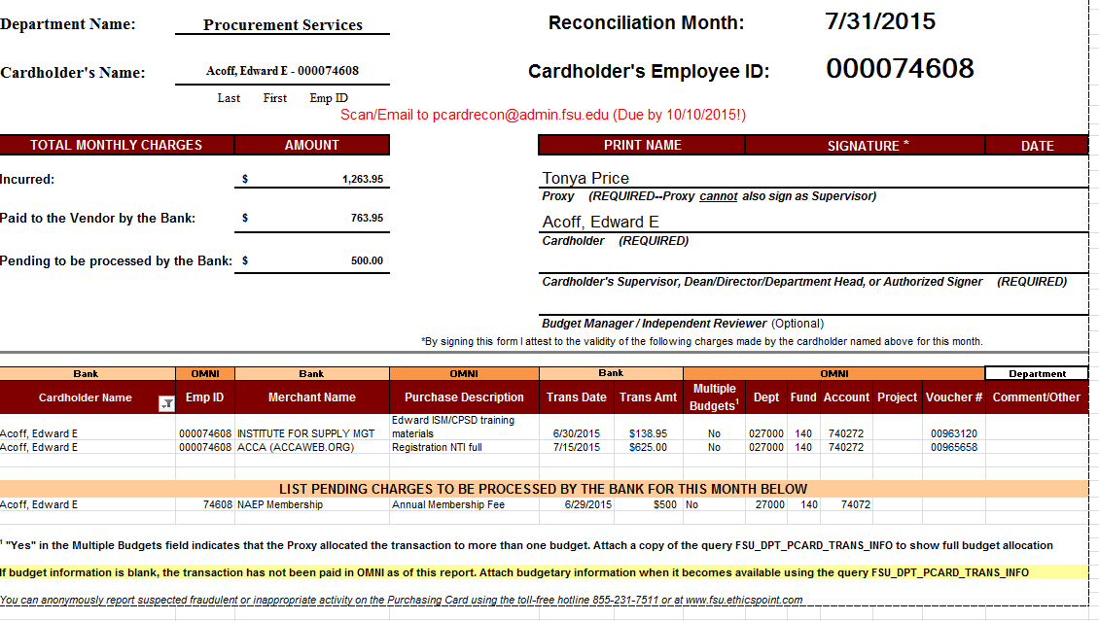
Completing a P-Card Reconciliation Form
If you have a transaction that the cardholder made in the reconciliation month but is not listed, you can manually add it under the List Pending Charges section.
Track this transaction to the following month to ensure it is paid.
Enter your cardholder's name into the Cardholder's Name field.
Enter the merchant's name into the Merchant Name field.
Enter the transaction date into the Trans Date field.
Enter the transaction amount into the Trans Amt. field.
If you have additional pending transactions, continue add those charges under the
List Pending Charges section.

Slide 12
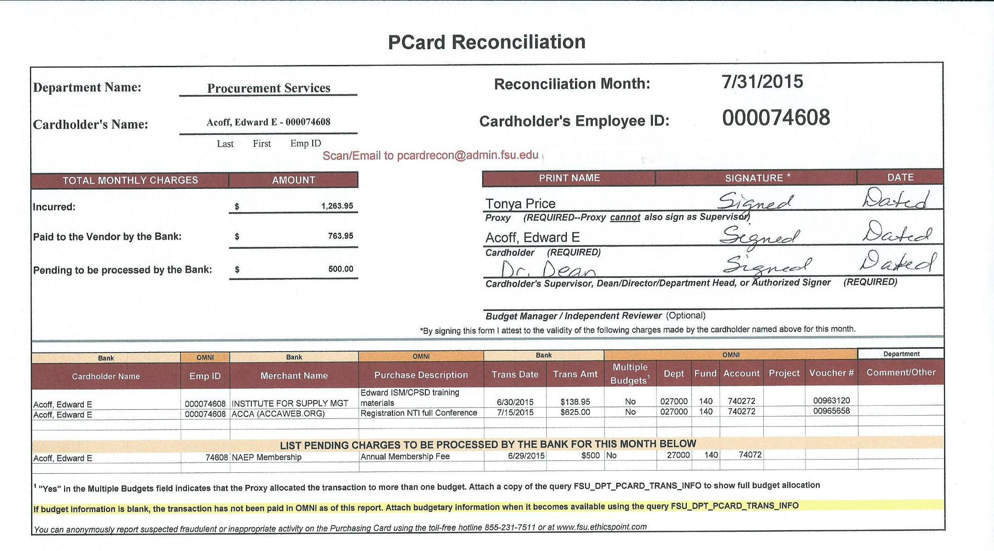
Completing a P-Card Reconciliation Form
Click the scrollbar to scroll back to the top.
The Total Monthly Charges have updated to include the pending charge you just added.
Print the form.
Once the form is printed, have the Proxy, Cardholder, and Cardholder Supervisor review the Reconciliation Form and the corresponding receipts and then sign and date the form attesting to the charges for the month.
NOTE: Proxy, Cardholder, and Cardholder Supervisor signatures are required.
Email the Reconciliation Form, corresponding receipts, and other documentation to pcardrecon@admin.fsu.edu.
You have completed the Reconciliation Form for this cardholder.
If you have more than one cardholder, you will have to complete this form for each cardholder.

Slide 13
Reviewing Pending Faxes List
NOTE: There is a firm due date for the Reconciliation Forms. Fax the forms by the due date to ensure no P-Cards are suspended in your department for non- compliance.
Click the Updated Faxes Pending tab on the bottom of the sheet.

Slide 14
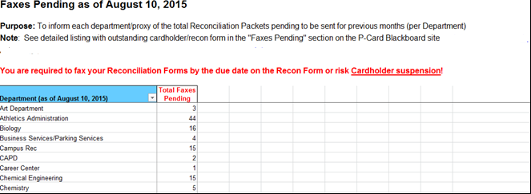
Reviewing Pending Faxes List
Scroll down until you find your department's name on the list. If there
is a number next to your department name, then you have outstanding
faxes pending.
To view the details on your missing faxes, you must return to the P-Card Blackboard site.

Slide 15
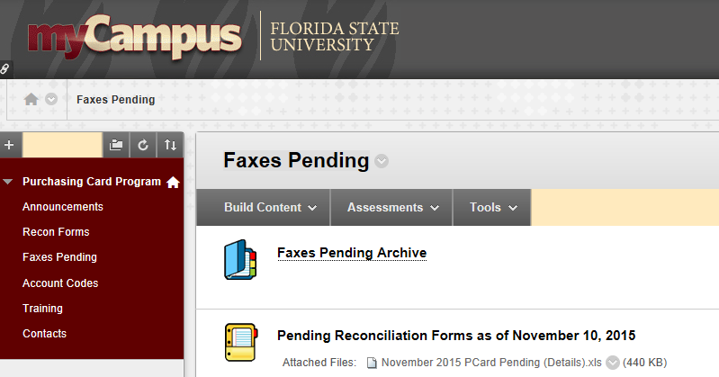
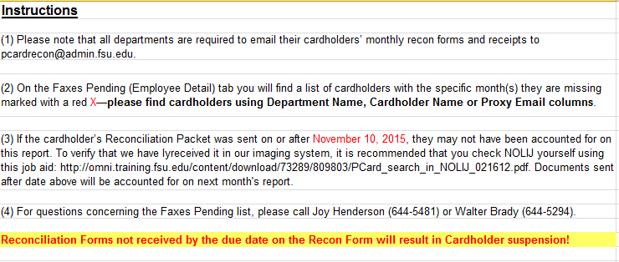
Reviewing Pending Faxes List
If you want to check for any pending faxes/reconciliations, go into Blackboard.
Click the Faxes Pending button on the left-hand menu.
Click on the appropriate month
Click the Faxes Pending (Employee Detail) sheet

Slide 16
Reviewing Pending Faxes List
When the spreadsheet opens up, select your department off the list
Find the Cardholders that have pending faxes
They will be marked with a red “X”
Those are the months that need to be completed or re-sent
If you have any questions regarding the reconciliation process or the pending faxes process, contact the P-Card Payment Processing Team found in the User Manual at procurement.fsu.edu.

