Slide 1
Processing Receipts

Slide 2
Processing Receipts on Purchase Orders
When goods that were ordered using a Purchase Order (PO) are physically received in the department or contractual services ordered on a PO have been performed, you should go into OMNI Financials to process a receipt for the goods and/or services
Since OMNI is our financial system, receipts are processed in OMNI to allow payments to be made from OMNI, even if the requisition was created in SpearMart.
By processing a receipt in OMNI, you are certifying that all goods and/or services listed on the receipt are received and/or completed and the supplier is due payment for those items/lines
You only want to process a receipt for the quantity of items shipped or lines for services performed, so FSU does not pay for items that FSU did not get or services not yet performed

Slide 3
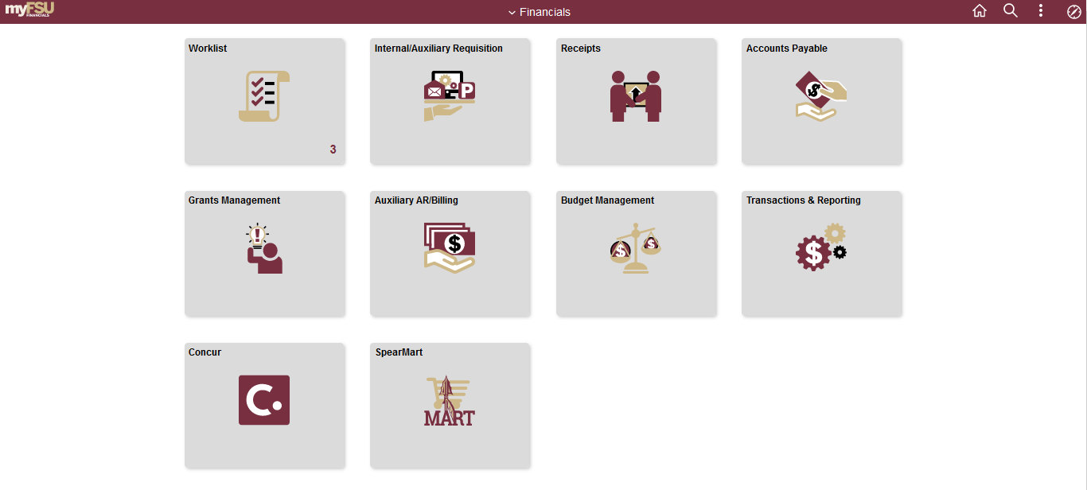
Steps to Process a Receipt on a Line Item PO
1. Access OMNI by navigating to https://my.fsu.edu/ and logging in with your MyFSU username and password, and then click the Financials Icon (FI) under MyFSU Links:
2. Click on the Receipts Icon:

Slide 4
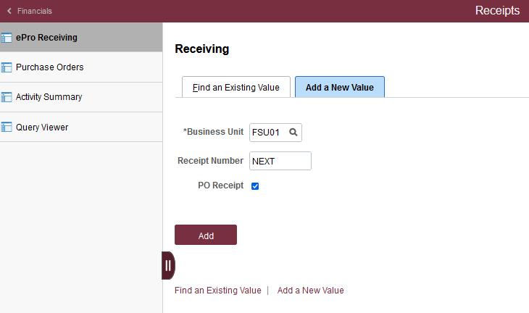
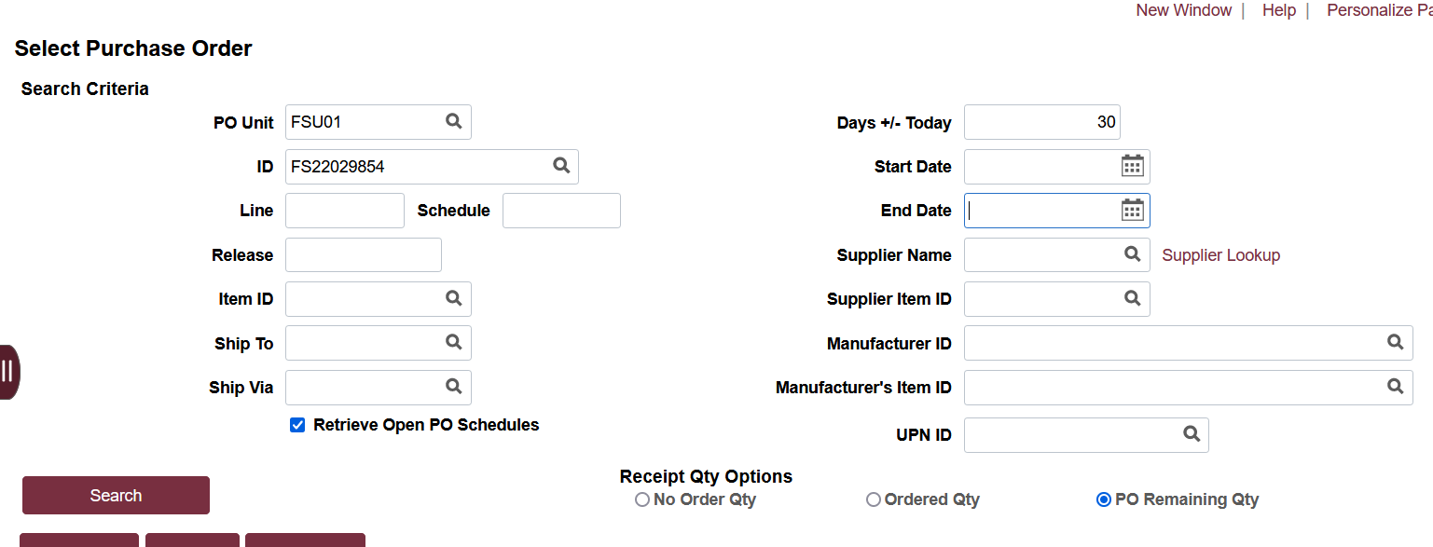
Steps to Process a Receipt on a Line Item PO
Click “Add”
When the search page comes up, remove all information except the PO Unit (FSU01), and the ID (PO Number).
Be sure the Ship To field, Days +/- Today, and Start Date fields are completely empty!
Click Search.

Slide 5
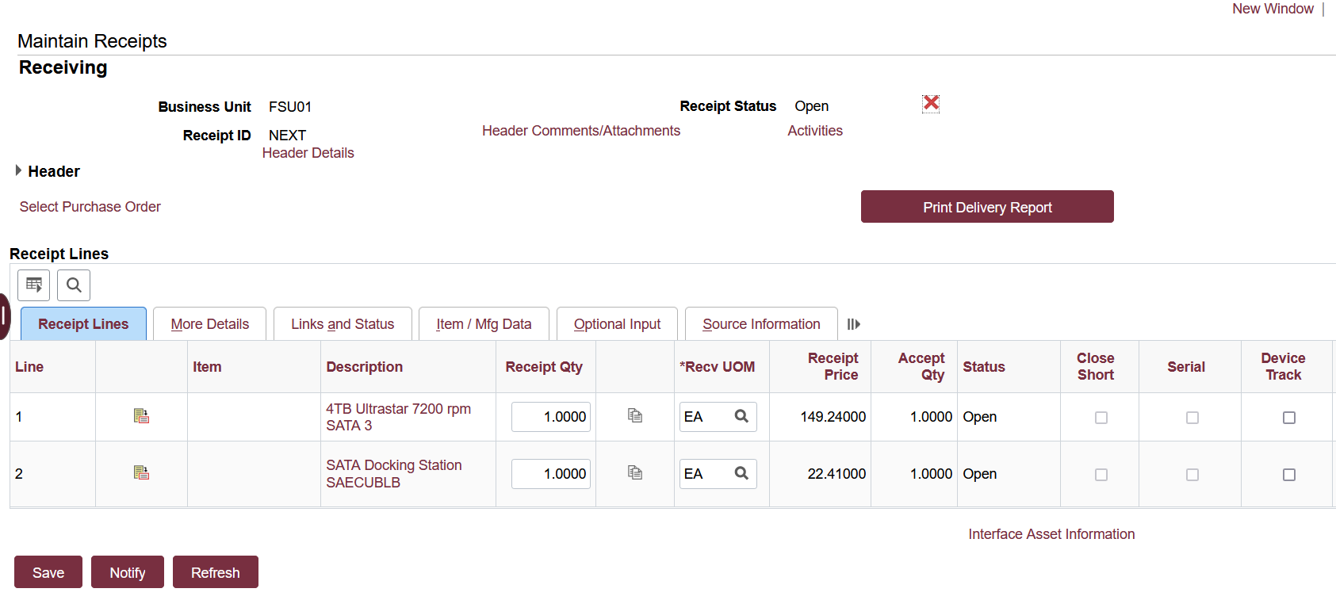
Steps to Process a Receipt on a Line Item PO
Select boxes next to lines to be received
Click “Ok”
Update quantities as needed to reflect the actual quantity or amount physically received and
Click “Save”

Slide 6
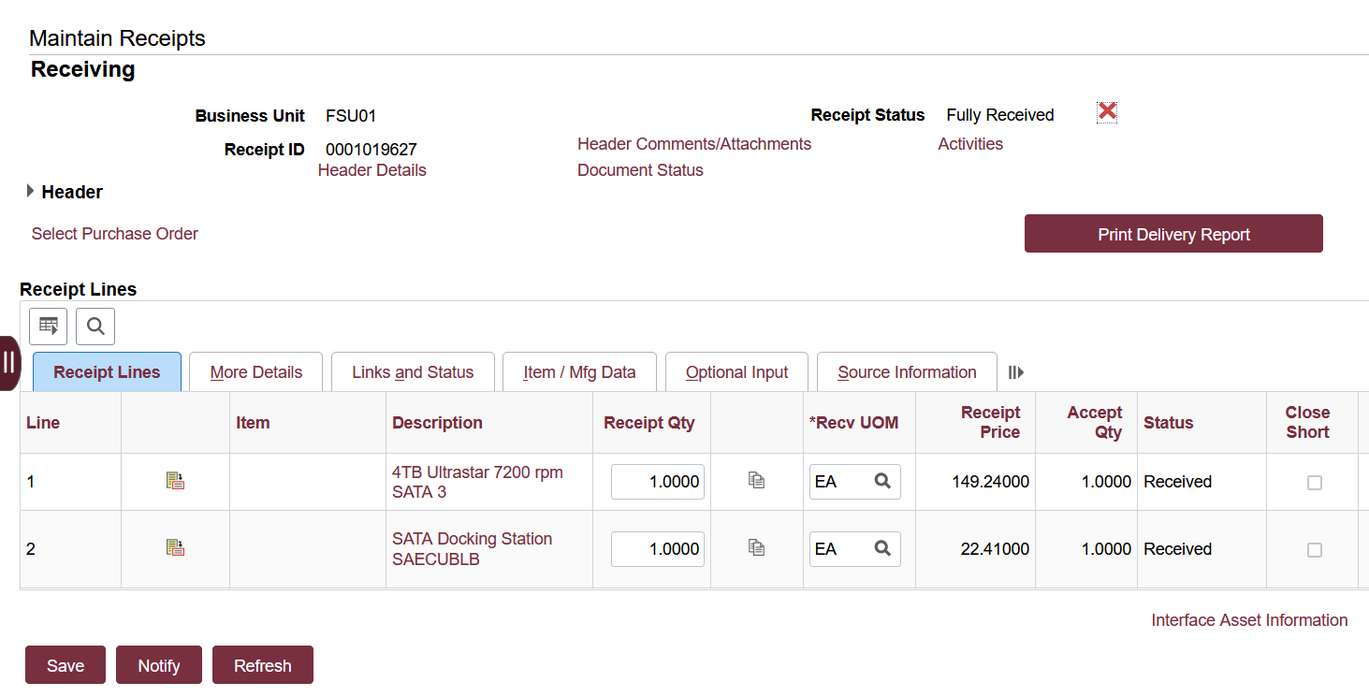
Steps to Process a Receipt on a Line Item PO
Receipt Number is located here after receipt is saved

Slide 7
Steps to Process a Receipt on a Blanket PO
1. Access OMNI by navigating to https://my.fsu.edu/ and logging in with your MyFSU username and password, and then click the Financials Icon (FI) under MyFSU Links:
2. Click on the Receipts Icon:

Slide 8
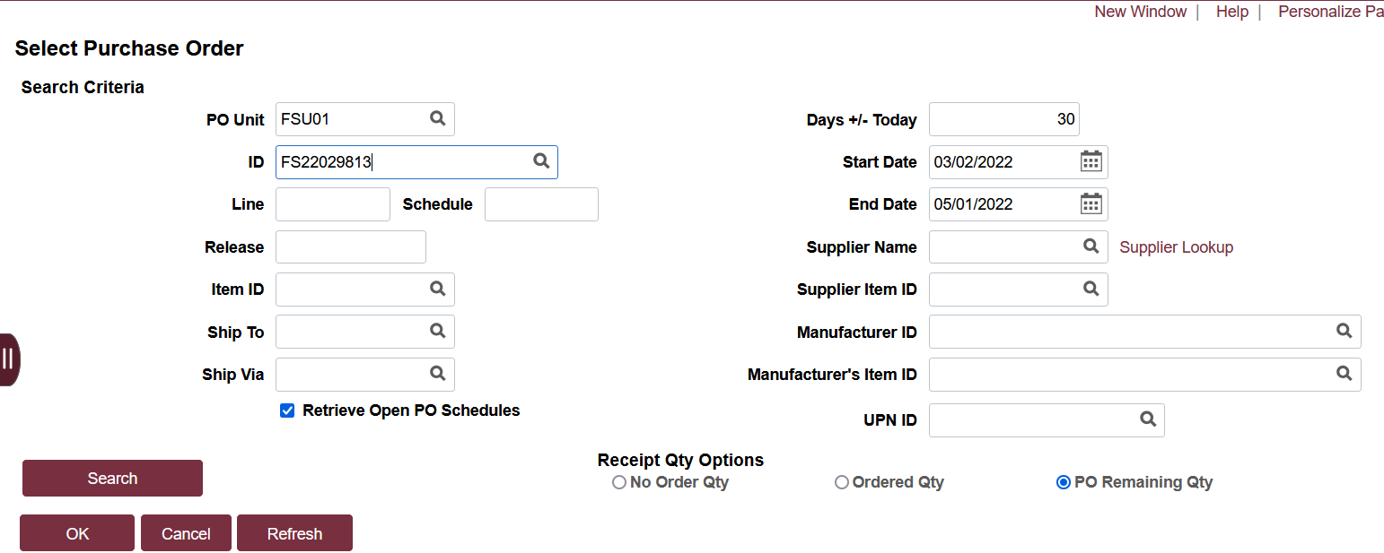
Steps to Process a Receipt on a Blanket PO
Click “Add”
When the search page comes up, remove all information except the PO Unit (FSU01), and the ID (PO Number).
Be sure the Ship To field, Days +/- Today, and Start Date fields are completely empty!
Click Search.

Slide 9
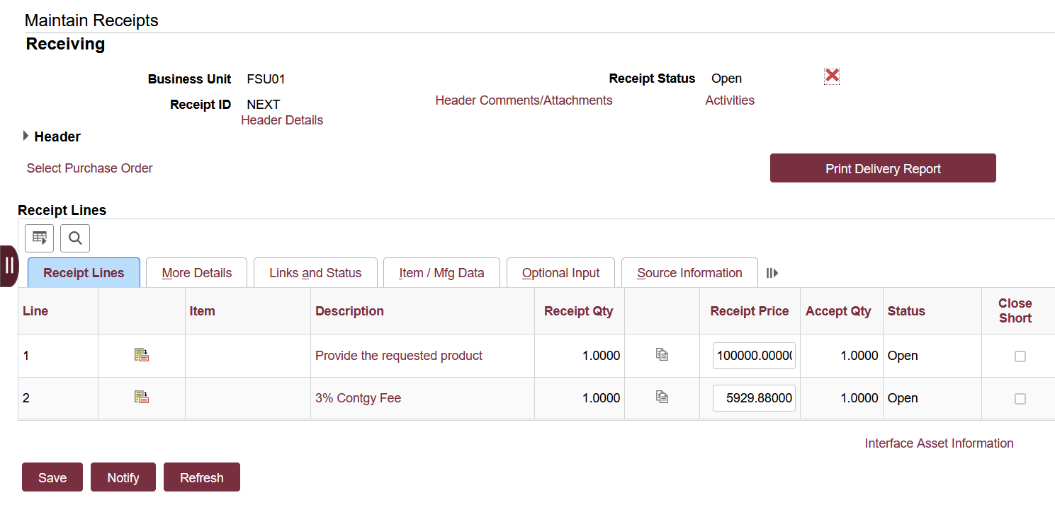
Select box/boxes next to lines to be received
Click “Ok”
The total amount on the PO will come up.

Slide 10
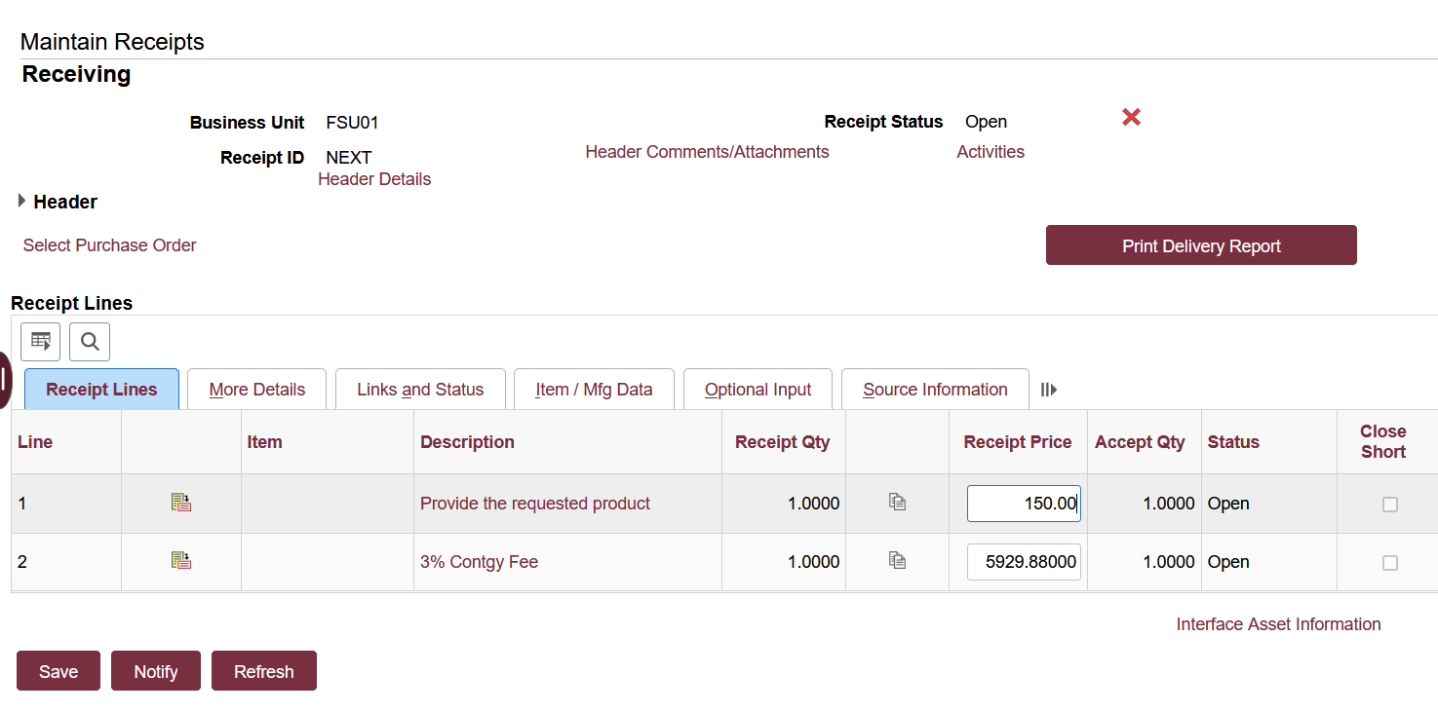
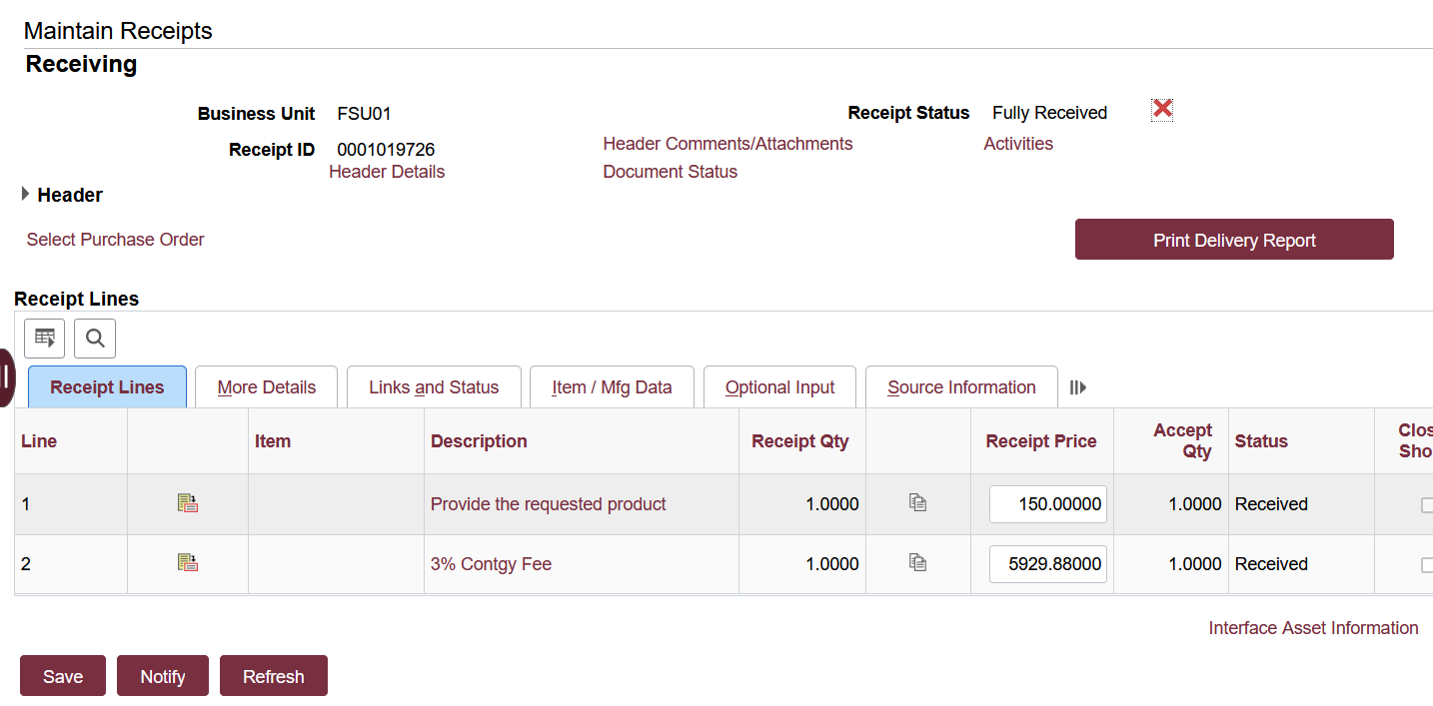
Update the quantity to match the receipt/invoice you are receiving against. In this example, we are receiving 150.
Click “Save” and your receipt ID will come up.

Slide 11
Steps to Cancel a Receipt in OMNI
Sometimes it is necessary to cancel a receipt to allow a change request or if an item was returned to the supplier, etc.
NOTE: You cannot cancel a receipt if a payment was already made using that receipt.
1. Access OMNI by navigating to https://my.fsu.edu/ and logging in with your MyFSU username and password, and then click the Financials Icon (FI) under MyFSU Links:
2. Click on the Receipts Icon:

Slide 12
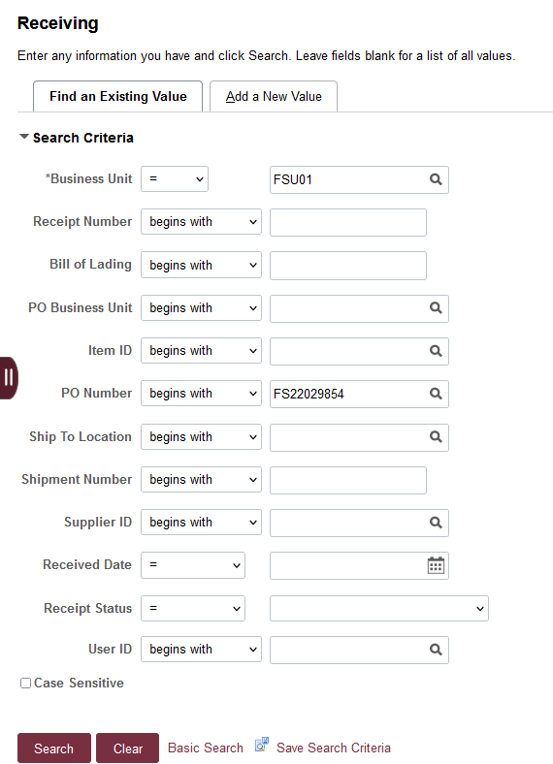
Steps to Cancel a Receipt in OMNI
Click the “Find an Existing Value” tab.
Then enter the PO number or the Receipt number in the appropriate fields, then click “Search”

Slide 13
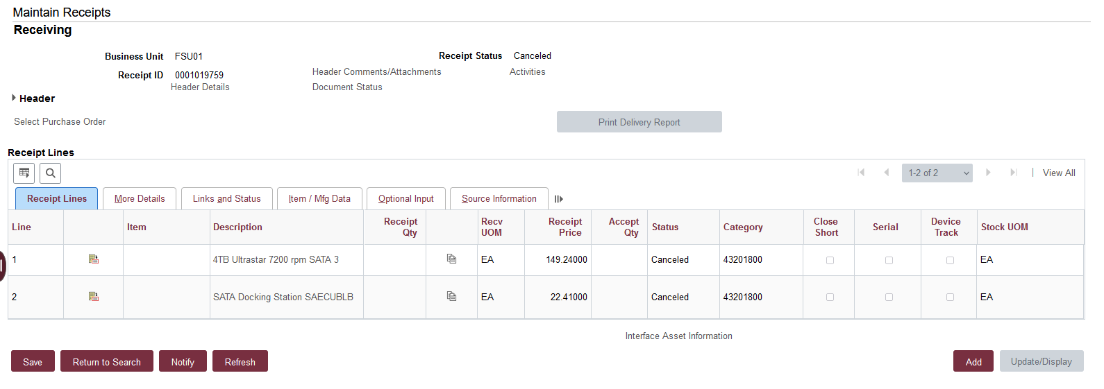
Steps to Cancel a Receipt in OMNI
1. Click the red “X” at the right
2. Answer “Yes” to the question that pops up
3. Once done, the receipt is cancelled

Slide 14
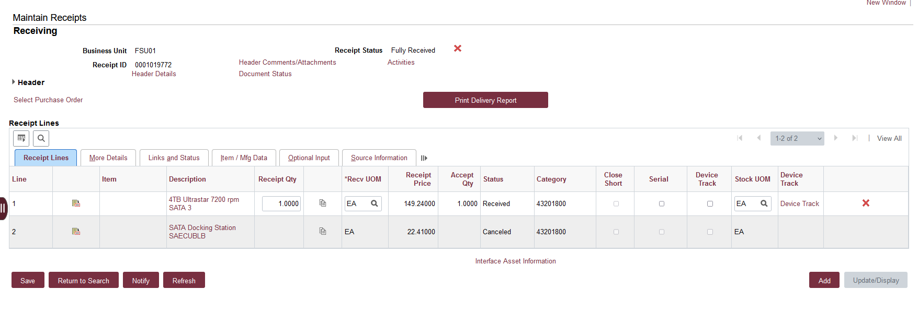
Cancel a line on a Receipt in OMNI
If the PO has several lines and you only want to cancel one item, just click the “X” to the right of that item. If you want the entire receipt cancelled, click the red “X” at the top.
This example shows the cancellation of line #2 only

Slide 15
Reviewing Receipts in OMNI
Sometimes it is necessary to review existing receipts to ensure something has been received on properly.
NOTE: After viewing receipts, you cannot cancel a receipt if a payment was already made using that receipt.
1. Access OMNI by navigating to https://my.fsu.edu/ and logging in with your MyFSU username and password, and then click the Financials Icon (FI) under MyFSU Links:
2. Click on the Receipts Icon:

Slide 16
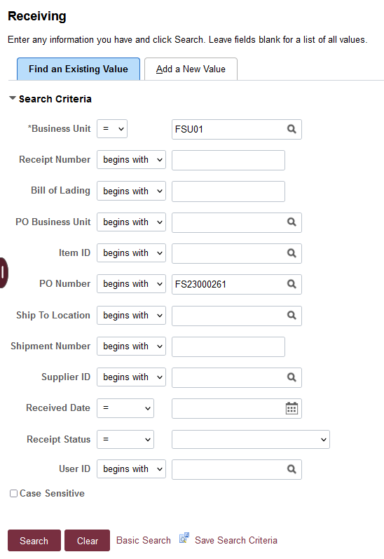
Reviewing Receipts in OMNI
Click the “Find an Existing Value” tab.
Then enter the PO number or the Receipt number in the appropriate fields, then click “Search”

Slide 17
Reviewing Receipts in OMNI
All existing receipts associated with the PO will appear. Important fields to note when reviewing: Receipt Number, Received Date, Price Per Receipt, and the User ID of the individual that created the receipt. You can review additional receipt information by clicking on the receipt number.
In this instance, we will click on Receipt # 0001049372

Slide 18
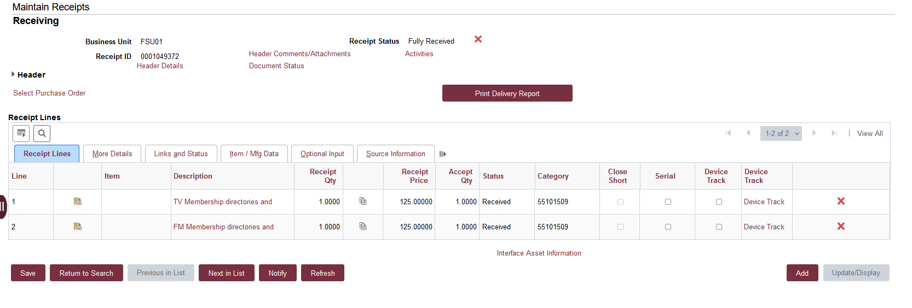
Reviewing Receipts in OMNI
Receipt # 0001049372 is shown below. This screen shows the line number, receipt quantity, receipt price, etc. You can click “Next in List” or “Return to Search” to view additional receipts.

