Slide 1
Welcome to SpearMart Training!

Slide 2
Agenda
Introductions
SpearMart Enhancement Project Background
Key Shopping Concepts
Hands On
Wrap-up

Slide 3
Introductions
Name
Department
Why are you in the class?
What do you hope to learn from this class?

Slide 4
Housekeeping
Keep off computers until Hands-On training begins
Restrooms are located…
Please silence cell-phones at this time
Keep side conversations to a minimum during training
Closely follow the instructor during Hands-On sessions
  Please do not deviate away from trainer’s instructions
  Please do not attempt to skip ahead
Keep room clean for the next group
Feel free to ask questions throughout the training

Slide 5
SpearMart Enhancement Project Background

Slide 6
Why Are We Doing This?
Today
FSU utilizes SpearMart (formerly known as E-Market) in a very limited capacity to shop for products and services from suppliers online catalogs.
End users have to navigate between multiple user interfaces (MyFSU Portal, OMNI and SpearMart) to complete procurement transactions.
Tomorrow
End users will be able to initiate all procurement requisitions from within SpearMart
All requisition and purchase order activity will take place in SpearMart including:
  Shopping
  Requisition Creation
  Workflow Approvals
  Order Distribution
We want to create a more cohesive user experience and deliver greater efficiency to FSU’s procurement processes!

Slide 7
Benefits/Goals
Provide a “One Stop Shop” for all procurement activity
Streamline the Source to Purchase Order process
Standardize requisition/form workflow and approvals
Move to paperless transaction processing
Simplify the procurement channels available to campus
Enhance process efficiency & increase responsiveness
Deliver outstanding customer service

Slide 8





SpearMart Shop to PO Process
Cart
Requisition
Requisition Approval
Purchase Order
Shopping
SpearMart
Catalog (Punchout & Hosted) Shopping
Forms for non-catalog purchases
Comments & Attachments
Requisition
User-friendly shopping and requisition creation
Include comments & attachments
Allocate accounting
Requisition workflow
Approval(s)
Catalog purchases
< $2,500 do not require dept. approval
Non-catalog purchases require dept. approval
Sponsored projects have separate workflow
Standard Department and dollar level workflow
Conditional workflow for IT, EH&S, Facilities, Grants, Capital, etc…
Procurement
Review and approve non-catalog purchases
Review and approve change order requests
Purchase Order
POs created upon approval
Automated dispatch to supplier via e-mail or fax
Catalog POs dispatch electronically to suppliers

Slide 9



OMNI Receipt to Pay Process
Receiving
Invoice Entry
Matching
Payment
Receiving
Confirm receipt of products/goods
Verify services have been performed
Invoice
Receive invoices from suppliers
Invoices entered by AP
3-Way Match
Match PO, Receipt, & Invoice
Payment
Payments scheduled and made based on agreed supplier terms

Slide 10
Shopping Concepts

Slide 11
Roles
Role | Permissions & Tasks Performed
Shopper | Search for and select the goods/services in SpearMart they need to purchase Create a Shopping Cart in SpearMart Assign completed shopping carts to a Requester
Requester | Same shopping capabilities as a Shopper Create purchase requisition Validate/add accounting information to a requisition May verify the purchase is appropriate and allowable Submit requisition for approval (Note: Department approval not needed for catalog purchases < $2,500)
Approver | Same shopping capabilities as a Shopper Decide if a user is authorized to spend against the assigned budget Final determination a purchase is appropriate & allowable Approve or return requisitions

Slide 12
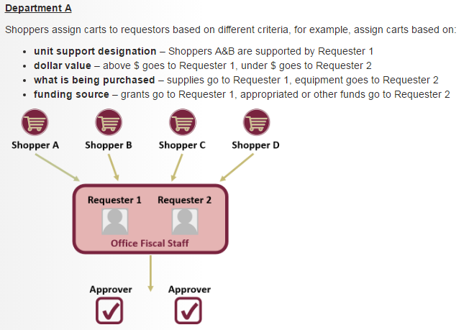
Roles: Example 1

Slide 13
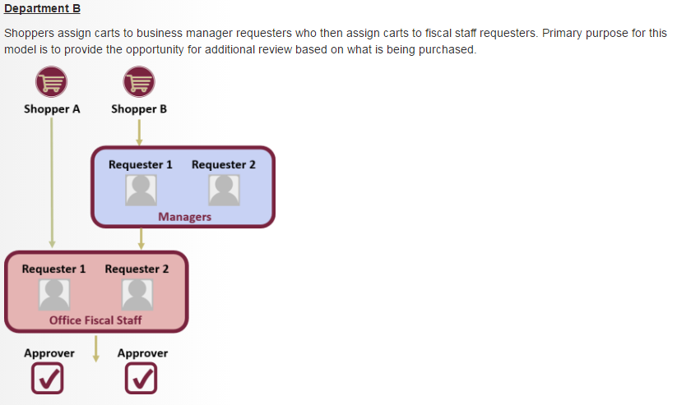
Roles: Example 2

Slide 14
Methods for Shopping
Method | Description
Punch-out Catalog | Catalogs provided by suppliers FSU has a larger contract with Shop from a supplier’s customized web site with FSU contracted products and pricing At checkout, item details are automatically populated in SpearMart shopping cart.
Hosted Catalog | Catalogs provided by suppliers FSU has a smaller contract with and/or limited to selling a portion of their products on contract Supplier products are stored directly in SpearMart and are searchable & shopped within SpearMart
Forms | Primary method for requesting products & services not available in a supplier catalog Also used for making other purchasing related requests (Approver Role, P-Card Application, etc…) Method for requesting PO change orders

Slide 15
Hands On Training
Notes:
Trainer: Refer to the syllabus for Hands On session details

Slide 16
Shopping Guidelines
Catalog and non-catalog line items should be on separate requisitions
One supplier per requisition
One type of form can be used on a single requisition
(ex: Pcard Application, monthly copier & overages)
Use the Comments tab to provide notes and attachments to approvers/buyers

Slide 17
QUESTIONS?

Slide 18
Closing Items
Go-Live: 3/20/17
Training Documentation: procurement.fsu.edu/training
Support Contact: SpearMart@fsu.edu or 850-644-2260
Training accounts are designed only for classroom use, please refrain from accessing these accounts outside of class for the courtesy of future trainees

Slide 19
Appendix

Slide 20
Punch-out Catalog Suppliers
Supplier | Commodity
Airgas | Lab Supplies & Equipment
Apple Computer | Technology
B&H Photo Video | Technology: Audio & Visual
Bio-Rad | Lab Supplies & Equipment
Carolina Biological Supply Company | Lab Supplies & Equipment
CDW-G | Technology
Complete Book & Media Supply, Inc. | Books
Connection - Public Sector Solutions | Technology
Dell | Technology
Fastenal | Facilities: MRO Supplies/Tools
Ferguson Enterprises, Inc. | Facilities: MRO Supplies/Tools
Fisher Scientific | Lab Supplies & Equipment
Grainger, Inc. | Facilities: MRO Supplies/Tools
HD Supply Facilities Maintenance | Facilities: MRO Supplies/Tools
Henry Schein Inc. | Medical/Dental/Athletic Training Supplies
HON (CDS) | Furniture
Lowe's Companies, Inc. | Facilities: MRO Supplies/Tools
Office Depot | Office Supplies
Office Environments (Herman Miller) | Furniture
Perdue Inc. (Steelcase Inc.) | Furniture
Sigma-Aldrich | Lab Supplies & Equipment
VWR International | Lab Supplies & Equipment

Slide 21
Hosted Catalog Suppliers
Supplier | Commodity
Audio Visual Innovations Inc. | Technology: Audio & Visual
Beckman Coulter Inc. | Lab Supplies & Equipment
DADE Paper | Facilities: Paper Products
New England Biolabs, Inc. | Lab Supplies & Equipment
QIAGEN, Inc. | Lab Supplies & Equipment

