Slide 1
Procurement Training

Slide 2
Overview of University Procurement
What we buy and how we buy it
There must be a procurement need and an appropriate method of procurement
We are a public University – there are state and federal laws, regulations, policies and procedures we must follow

Slide 3
Overview of Procurement Services Team
Procurement Services Organizational Chart
Meet the Staff | Procurement Services
Procurement Services consists of four primary areas:
Procurement
Procurement Card (PCard)
Supplier Relations (Payment Works)
Contract Administration

Slide 4
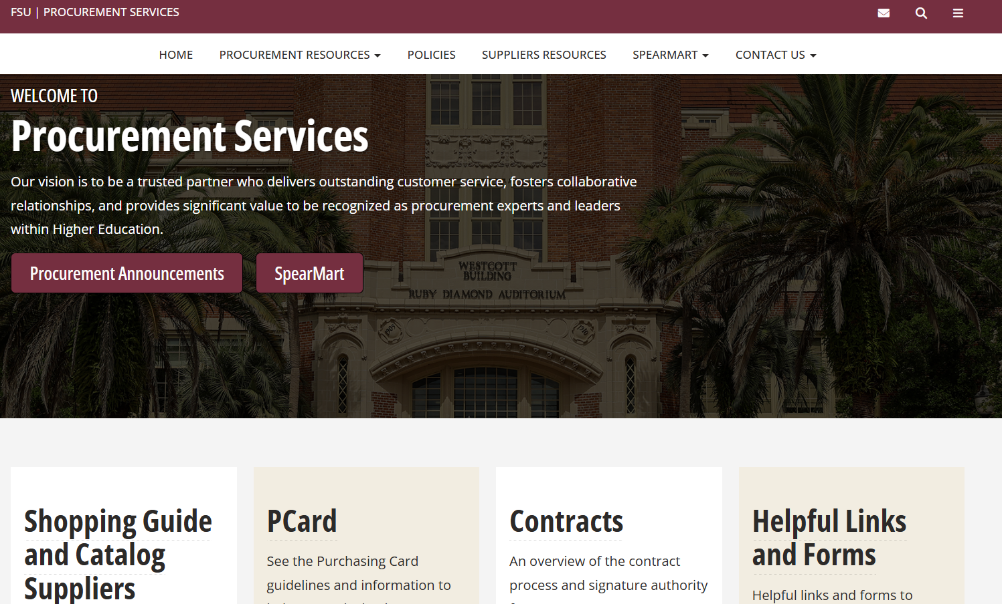
Notes:
This is our home page… you can get there by going to procurement.fsu.edu
Notice the tabs along the top and ICONS on the bottom.
Take them into the real website and navigate through to show them different sections…

Slide 5
Tax Exempt
All purchases in Florida are tax exempt
Certificate of Exemption
Check quotes to ensure tax is NOT included
If a delivery address is outside of Florida, sales tax may apply

Slide 6
Fund Types
Certain fund types have different procurement requirements
https://controller.vpfa.fsu.edu/services/accounting-reporting/fund-structure
Education & General, most Auxillary, and Designated funds must follow procurement rules/policies
Contract & Grant​ and other research related funds must follow procurement rules/policies and may have special requirements
Foundation, Boosters, and Personal funds are not covered under procurement requirements discussed today​

Slide 7
Expenditure Guidelines
Expenditure Guidelines will provide details as to what purchases are allowed on different fund types
Once you’ve identified the fund type, check the expenditure guidelines to ensure its an allowable purchase
If there is split funding, follow the fund type rule with the most stringent rules
https://controller.vpfa.fsu.edu/expenditure-guidelines

Slide 8
Supplier Code of Conduct, Ethics and Conflict of Interest
Supplier Code of Conduct.pdf
Suppliers and FSU employees must abide by a strict Code of Ethics
No potential conflict is too small or large to disclose to Procurement
Make Procurement aware of any spouses or relatives employed by a current or potential Supplier related to a competitive solicitation
Office of Compliance and Ethics
​
​

Slide 9
Gifts and Gratuities
Supplier Code of Conduct.pdf
No gifts, meals, travel, entertainment, or other thing of value may be offered or given to FSU employees while a procurement action is active or being negotiated.
Gifts can be received by contracted suppliers if less than $100, but not from non-contracted suppliers (example: donations, door prizes, etc.)
No cash in the form of a gift is allowed
FSU employees may accept gifts if $100 or less and as long as the applicable state and federal laws are followed
Finance and Administration employees are not allowed to accept any gifts, even if $100 or below
Office of Compliance and Ethics
​
​

Slide 10
Payment Vehicle and Method of Procurement
FSU’s frequent payment vehicles are a Procurement Card(PCard) or Purchase Order (How will you purchase the item)
Method of Procurement (The process in which you purchase a commodity or service)
​
​

Slide 11
Procurement Method Quick Reference Guide
 | Existing FSU Contract or SpearMart* | PCard | Quotes | Formal Solicitation (Invitation to Bid or Invitation to Negotiate) | Sole Source | Sponsored Research Exemption (SRE)
$ Amount | any $ amount | $1 - $2,500 or approved limit | $25,000 - $149,999 require written quotes | $150,000 and up | $25,000 and up | $150,000 and up (Grant Funds)
Department Responsibility | Purchase through SpearMart or visit the following links: Shopping Guide or Contracts for available contracts | Consult P-Card Manual or Procurement Services as required for permitted vs. prohibited purchases | Provide specs for goods or services Obtain 3 quotes | Contact Procurement Services to discuss Provide specs for goods or services Determine advisor (non-voting and subject matter expert) and evaluation committee members (voting members) for ITNs | Complete Sole Source Form in SpearMart Provide specs for goods or services | Submit Sponsored Research Exemption paperwork to the Office of Research for approval If not approved, consult with Procurement Services for next steps
Procurement Services Role and Responsibility | Provide support as needed including technical support, advice, identification of existing FSU contracts or piggyback options ** | Provide support as needed including technical support, advice, identification of best value and possible suppliers, including suppliers that support university diversity efforts | Review specs Obtain Minimum of 3 quotes in collaboration with the requesting department May contact other sources, obtain other quotes or utilize Other Entity Contracts** | Review specs Invitation to Bid (ITB): Obtain formal bids. Award based on meeting all specs at lowest cost. Used for standard off-the-shelf goods or services Invitation to Negotiate (ITN): Obtain formal proposals. Lead negotiations with suppliers. No point scores or weights used. Awarded by defined criteria, best value to FSU, and consensus of committee | Validate/ Approve Sole Source For purchases $150K and up obtain cost analysis documentation and posts award on website for 72 hours | If SRE approved, issue PO. and posts award on website for 72 hours If no SRE approval, consult Department on other options
Est. Time to Complete | 0 to 2 days | 0 to 2 days | 3 days to 3 weeks | ITB: 1-3 months ITN: 3-6 months | 2 days to 3 weeks | 2 days to 2 weeks
* Most Preferred Procurement Method
** Piggyback options are contracts FSU can use from other entities which include State of Florida agency or department, the Federal Government, other states, political subdivisions, not-for-profit cooperatives or consortia, or any independent college or university (Board of Governors Purchasing Regulation 18.001(1)(c))
Note: Life of contract/PO or repetitive purchases determines the dollar threshold
Notes:
This is just a quick reference guide that can be found on our web site. It provides a lot of the information I have covered in a one-page document for department use.
Just remember, we look at the overall life cycle of a contract (not just price but maintenance, upgrades, etc. included).

Slide 12
Procurement Exemptions
Use of an exemption requires approval by Procurement
Emergency exemption
Sole Sources
Purchase of Insurance
Memberships/subscriptions essential to FSU business
Cable services and utilities
Academic reviews and lectures
Legal services
Auditing services
Training and education services
Buying Exemptions | Procurement Services
​
​

Slide 13
Legislative Changes
Foreign Countries of Concern
288.860, F.S., BOG Regulation 9.012
Purchases FSU makes from foreign countries of concern (i.e., money, property, or services flowing out of the university)
Human Trafficking Declaration
HB 7063 “An Act Related to Human Trafficking”
Requires all non-governmental suppliers to declare, under penalty of law, that they are not using coercion for labor or services

Slide 14
Foreign Countries of Concern
In accordance with the Board of Governor’s ensuing Regulation 9.012, “Foreign Countries of Concern” include:
The People’s Republic of China (Hong Kong, Macau)
The Russian Federation
The Islamic Republic of Iran
The Democratic People’s Republic of Korea (North Korea)
The Republic of Cuba
The Venezuelan regime of Nicholas Maduro
The Syrian Arab Republic

Slide 15
What this Means
These new process(es) applies to any agreements starting, or renewed/extended, after July 1, 2024
BOG Approval may be needed for certain purchases that enter into agreements with certain foreign countries of concern.
Questions for Suppliers in PaymentWorks during onboarding
Indicate they are not a foreign principal of, or have their principal place of business in, a foreign country of concern
Attest they do not provide coerced labor or services

Slide 16
What this Means (Cont.)
PCard purchases will require prior approval and a waiver in advance of any purchase from these countries.
Updated language in the FSU purchase order standard terms and conditions, as well as the university’s standard contract templates.
SpearMart’s sourcing module asks respondents to competitive solicitations to confirm they are not a principal of a foreign country of concern.

Slide 17
How You Can Help
Departments are encouraged to be cautious when sharing university data, intellectual property, purchasing commodities or services for academic or research purposes, and/or purchasing commodities and services where the point of origin is unknown (i.e., Amazon Marketplace).
Not sure of the seller or point of origin? Please call Procurement Services prior to making a purchase.

Slide 18
Amazon Purchases
Amazon purchases should be a last resort purchase option after checking all contracted suppliers on Procurement Services website. Amazon purchases are ONLY allowed when items or comparable items are not available from contracted suppliers.
Always verify the seller or point of origin where the item is being shipped from Amazon. Most Amazon fulfillment centers are okay however must be based in the United States.
Not sure of the seller or point of origin? Please call Procurement Services prior to making a purchase.
What if I can get it for less expensive on Amazon? Typically, not a valid justification for purchase and must coordinate with Procurement Services to verify if contracted supplier can offer competitive price. Additional approvals may be required by Director of Procurement prior to purchasing.

Slide 19
Costco Purchases
FSU has a Costco membership and is the preferred option.
PCards are required for Costco purchases and cannot be placed on a requisition.
All purchases are sales tax exempt.
FSU’s membership #: 111905982784.
For additional information on Costco purchases: https://procurement.fsu.edu/supplier/costco
Note: Departments can purchase from Sams however please contact Procurement Services first and justify why the item cannot be purchased from Costco. Departments need to use an individual’s own membership # and use a PCard for the purchase. Please be sure to present the tax exemption certificate to avoid sales tax.

Slide 20
Gift Card Purchases
Gift cards can only be purchased for research participants or for employees who are participating in research projects. This does not include employee incentives, awards, etc. per the Controller’s Office Expenditure Guidelines.
Approved fund codes to purchase gift cards with are 110, 140, 520-560 (except 556), and 599.
Gift cards can be purchased thru Tango (pcard only), Prolific (pcard only) and Blackhawk (Spearmart punchout)
Spearmart requisitions to Blackhawk must include an internal note/comment stating whom the gift cards will be provided to and for what purpose. Also, attach an approved Institutional Review Board (IRB) protocol or the letter that states the study is exempt.
For additional information see https://procurement.fsu.edu/taxonomy/term/131

Slide 21
SpearMart Roles

Slide 22
Requisition Requirements
If a supplier offers a SpearMart catalog, most line-item details will auto populate (ease of use for shopping)
Commodity orders must include: Description of item(s) to include nomenclature (name), catalog/item/part #, make, model, manufacturer, etc.
Service orders must include: Description of services to be performed by supplier, beginning and ending dates, FSU Contract Manager and full phone number
Complete additional specifications/information included on each SpearMart form
If there is split funding, follow the fund type rule with the most stringent rules
Helpful tip – Designate delegates for entering and approving requisitions

Slide 23
Requisition Forms
Blanket Order Request
Recurring commodity purchases from a specific supplier
Receipt by amount
Allow one change order per year
Must include at least two authorized signers
Non-Catalog Request
Commodities that are not available in a catalog
Receipt by quantity
Non-Catalog Request-Sole Source
Contact procurement for purchases over $25,000
Services Request-Fixed
Fixed prices with a quantity of one
Receipt by amount
Services Request-Variable
Quantities greater than one with a unit of measurement (hourly, weekly)
Receipt by quantity

Slide 24
Requisition Forms Key Points
Always attach a quote when available, and ensure that the requisition mirrors the quote (each line with an amount greater than $0.00 should be on a separate line)
If a quote contains signature lines and/or any extensive language about terms and conditions, confirm with the supplier that they will accept our purchase order in lieu of any signed agreement
$0.00 line amount details should be added to a line description that contains an amount to ensure the item that is $0.00 is printed on the purchase order
If a contract is associated with the purchase, be sure to include the contract number in the designated field
If any signatures are required, forward documents to contracts@fsu.edu for review.
Ensure your contact information is correct and includes name, phone number, and email so that it prints on the purchase order

Slide 25
What is a Purchase Order?
The PO is a Contract between the Supplier and FSU
Legally binding document and cannot be changed without approval from both parties
Authorization from FSU for the Supplier to provide commodities and/or services as per the line item/specifications details
A Purchase Order is also known as the payment vehicle
Please coordinate any changes to purchase orders with the supplier

Slide 26
Confirming Order
After-the-fact purchases where a requisition is entered into SpearMart after the commodities/services have begun or been fulfilled by a Supplier
Anyone obligating the expenditure of FSU funds without a PO established may have to pay for that obligation out of their own personal funds
This applies to all purchases, regardless of funding source

Slide 27
Questions and Answers
Website: procurement.fsu.edu
Please contact procurement@fsu.edu or at x46850 for additional assistance
Thank you for attending!

